Slide 2
About these Slides
These slides highlight new data presented at EASL Congress 2025.
Feel free to use, adapt, and share these slides for your own personal use – please acknowledge EASL as the source​.
Abbreviations and full abstract texts are provided within the slide notes​.
Submitted abstracts are included in the slide notes but the final presented data may differ​.
Click on this symbol , to return to the​ contents page.
Click on this symbol , to go to a specific page.
These slides serve as an educational resource and should not be used for patient management decisions.
Always verify information before applying it in clinical practice or using any therapies described.

Slide 3
Contents
Viral Hepatitis: Experimental and pathophysiology
Go to Section
OS-029-YI
Spatial profiling of HBV and HDV infection in human liver samples
OS-103
The nucleoside analogue NITD008 strongly suppresses viral replication in immunodeficient
humanized mice stably infected with the hepatitis E virus
FRI-245-YI
Hepatitis E virus entry requires the cholesterol transporter Niemann–Pick C1
Viral Hepatitis C: Clinical aspects including follow up after SVR
Go to Section
OS-100
Long term clinical outcomes in patients with chronic hepatitis C after direct-acting antiviral
treatment: a prospective study

Slide 4
Contents
Viral Hepatitis B and D: New therapies, unapproved therapies or strategies
Go to Section
THU-240
30% of inactive HBsAg carriers achieved clinical cure at 48 weeks with Pegylated Interferon alpha-2b therapy: a multicenter real-world study (STARHB Project in China)- 2.5 years data update
OS-010
Outcomes of 48 weeks of therapy and subsequent 24-week post-treatment period with tobevibart (VIR-3434) and elebsiran (VIR-2218) with or without pegylated interferon alfa-2a in chronic hepatitis B virus infection. Findings from the MARCH study
OS-073
Entry inhibitor Hepalatide combined with pegylated interferon-alpha 2a therapy resulted in cccDNA clearance in CHB patients: a phase II randomised, double-blind, placebo-controlled trial
OS-069
A Randomised trial of nucleos(t)ide withdrawal vs nucleos(t)ide withdrawal with adjuvant pegylated-interferon in HBeAg-negative hepatitis B virus infection to promote HBsAg clearance (NUC-B)
OS-070
Achieving undetectable hepatitis delta virus RNA at end of therapy with bulevirtide 10 mg/day with or without with pegylated interferon alpha is strongly associated with post-treatment virologic response in chronic hepatitis delta
Notes:
NEW

Slide 5
Contents
Viral Hepatitis B and D: Current therapies
Go to Section
OS-065
Long term outcomes after nucleos(t)ide analogue cessation – an extended follow up study from the RETRACT-B cohort
OS-066
Predictors of undetectable hepatitis delta virus RNA at 48 weeks after end of treatment with bulevirtide monotherapy in the MYR 301 study
OS-067-YI
Long term outcomes after nucleos(t)ide analogue cessation – an extended follow up study from the RETRACT-B cohort
Late breakers
Go to Section
LB25221
Final results of MYR301: a randomised phase 3 study evaluating the efficacy and safety of up to 144 weeks of bulevirtide monotherapy for chronic hepatitis delta and 96 weeks of posttreatment follow-up
Notes:
NEW

Slide 6
Viral Hepatitis
Experimental and pathophysiology

Slide 7
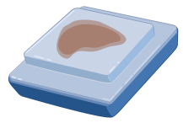
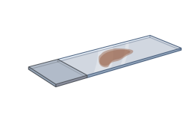
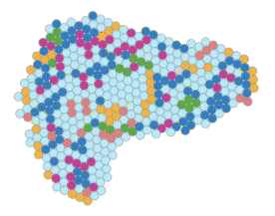
OS-029-YI Spatial profiling of HBV and HDV infection in human liver samples
Background & Aims Methods
Chronic HDV is the most severe form of chronic liver disease, with a rapid progression to cirrhosis and hepatocellular carcinoma.
Understanding the intricate relationships between HDV, HBV, and liver cells, as well as the host immune response is essential for developing effective prevention and treatment strategies.
Aim: To characterise the transcriptional landscape of the liver in HBV and HDV infected patients.
8 patients
3 HBV mono-infected
5 anti-HD Ab positive
3 HDV-RNA positive
2 HDV-RNA negative
Liver Biopsy
Liver Explant
FFPE human liver samples
Dual chromogenic immunostaining
HDAg
HBsAg
Spatial transcriptomics using 1000-plex RNA panel of CosMx.
Notes:
Abbreviations: HBV = Hepatitis B virus; HBsAg = Hepatitis B surface antigen; HDV = Hepatitis Delta Virus; HDAg = Hepatitis Delta antigen.
OS-029-YI
Spatial profiling of HBV and HDV infection in human liver samples
Maria Saez-Palma1, Marc Buendia2, Thais Leonel1, Ester García-Pras1, Ángela Sanzo-Machuca2, Mario Acera3, Anna Pocurull Aparicio1, Sara Battistella1, Maëlle Locatelli1, Sergio Rodriguez-Tajes1, Sarah Shalaby4, Asunción Ojeda4, Alba Díaz5, Yilliam Fundora6, Elisabetta Mereu3, Azucena Salas2, Xavier Forns1, Sabela Lens1, Sofía Pérez-del-Pulgar1
1Liver Unit, Hospital Clinic, University of Barcelona, IDIBAPS, CIBEREHD, Barcelona, Spain, 2Inflammatory Bowel Disease Unit, Hospital Clinic, IDIBAPS, CIBEREHD, Barcelona, Spain, 3Instituto de Investigación contra la Leucemia Josep Carreras, Badalona, Spain, 4Barcelona Hepatic Hemodynamic Laboratory, Liver Unit, Hospital Clinic - IDIBAPS, Barcelona, Spain. CIBEREHD, Barcelona, Spain, 5Barcelona Clinic Liver Cancer (BCLC) Group, Department of Pathology, Hospital Clínic de Barcelona, Universitat de Barcelona, Barcelona, Spain, 6Department of General and Digestive Surgery, Hospital Clinic de Barcelona, IDIBAPS, Barcelona, Spain
Email: msaezp@recerca.clinic.cat
Background and Aims: Chronic hepatitis D is the most severe form of chronic liver disease, with a rapid progression to cirrhosis and hepatocellular carcinoma. Understanding the intricate relationships between HDV, HBV, and liver cells, as well as the host immune response is essential for developing effective prevention and treatment strategies. Our study aimed to characterize the transcriptional landscape of the liver in HBV and HDV infected patients.
Method: We included 5 HBV/HDV coinfected patients (anti-HDV positive), 3 with detectable HDV-RNA (HDV+) and 2 with undetectable HDV-RNA (HDV-), and 3 HBV infected patients (as controls). We used dual chromogenic immunostaining to visualize HBsAg and HDAg in the liver (Bond RX, Leica). Spatial transcriptomics was applied to FFPE liver samples using CosMx Spatial Molecular Imaging (1000-plex RNA, Nanostring). Cell segmentation was performed using morphology visualization markers, including B2M/CD298, PanCK, CD45, CD68 and DAPI.
Results: The analysis of viral antigens revealed that in samples from HDV/HBV coinfected patients, most hepatocytes expressed high levels of HBsAg, but co-expression with HDAg was rare. Specifically, HDAg was restricted to areas with low or undetectable levels of HBsAg. By combining single-cell RNA sequencing (scRNA-seq) data with spatial transcriptomics, we identified over 30 cell types encompassing major populations of the immune system, as well as various subpopulations of hepatocytes, cholangiocytes, and Kupffer cells. Hepatocytes from HDV/HBV coinfected patients exhibited differential gene expression compared to HBV infected patients, characterized by the overexpression of more than 180 genes. Most of these genes were associated with signaling pathways related to the inflammatory response (IL6-JAK-STAT, TNF-NFκB), innate immunity (IFN response), and adaptive immunity (IL2-STAT5). These findings were also confirmed at an intra-patient analysis, where hepatocytes in areas expressing both HDAg and HBsAg showed greater activation than those expressing only HBsAg. Furthermore, in HBV infected patients, HBsAg expression was not only associated with the activation of pro-inflammatory pathways but also with pathways linked to cancer development, such as epithelial-mesenchymal transition.
Conclusion: The expression of viral antigens in the liver is associated with alterations in the host's transcriptome, highlighting the dynamic interplay between viral infection and host responses. Spatial transcriptomics provides a detailed view of the hepatic microenvironment, revealing pathway differences in HBV/HDV coinfection compared to HBV infection, at a cellular level. These findings provide a basis for identifying biomarkers and targets for hepatitis delta treatments.

Slide 8
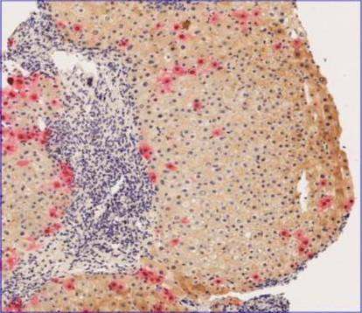
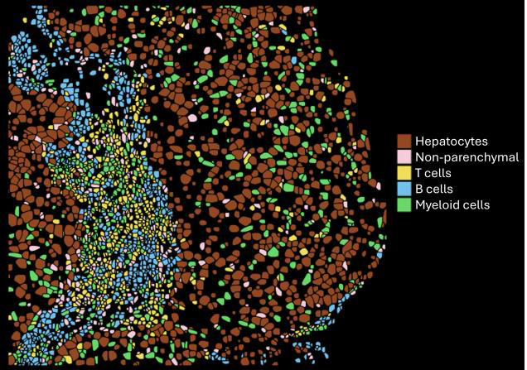
OS-029-YI Spatial profiling of HBV and HDV infection in human liver samples
Results
Conclusion
Viral antigen analysis
Spatial transcriptomics captures the complexity of the liver microenvironment and the heterogeneity of infection.
The expression of viral antigens in the liver is associated with local alterations in the host's transcriptomic landscape.
These findings highlight the dynamic interplay between viral infection and host responses and provide a basis for identifying biomarkers and targets for hepatitis delta treatments.
In HDV-infected patients, co-expression of
HDAg and HBsAg is rarely observed.
HDAg expression is confined to areas with low or undetectable HBsAg levels.
HBV Spatial Transcriptomics
30 cell types were identified including hepatocytes, non-parenchymal & immune cells.
Pathway analysis of HDV RNA+ compared to
HBV infected patients showed an upregulation of inflammatory pathways and IFN response.
Intra-patient analysis confirmed that areas
expressing HDAg showed greater proinflammatory pathway activation compared to only HBsAg-positive areas.
Notes:
Abbreviations: HBV = Hepatitis B virus; HBsAg = Hepatitis B surface antigen; HDV =Hepatitis Delta Virus; HDAg = Hepatitis Delta antigen.
OS-029-YI
Spatial profiling of HBV and HDV infection in human liver samples
Maria Saez-Palma1, Marc Buendia2, Thais Leonel1, Ester García-Pras1, Ángela Sanzo-Machuca2, Mario Acera3, Anna Pocurull Aparicio1, Sara Battistella1, Maëlle Locatelli1, Sergio Rodriguez-Tajes1, Sarah Shalaby4, Asunción Ojeda4, Alba Díaz5, Yilliam Fundora6, Elisabetta Mereu3, Azucena Salas2, Xavier Forns1, Sabela Lens1, Sofía Pérez-del-Pulgar1
1Liver Unit, Hospital Clinic, University of Barcelona, IDIBAPS, CIBEREHD, Barcelona, Spain, 2Inflammatory Bowel Disease Unit, Hospital Clinic, IDIBAPS, CIBEREHD, Barcelona, Spain, 3Instituto de Investigación contra la Leucemia Josep Carreras, Badalona, Spain, 4Barcelona Hepatic Hemodynamic Laboratory, Liver Unit, Hospital Clinic - IDIBAPS, Barcelona, Spain. CIBEREHD, Barcelona, Spain, 5Barcelona Clinic Liver Cancer (BCLC) Group, Department of Pathology, Hospital Clínic de Barcelona, Universitat de Barcelona, Barcelona, Spain, 6Department of General and Digestive Surgery, Hospital Clinic de Barcelona, IDIBAPS, Barcelona, Spain
Email: msaezp@recerca.clinic.cat
Background and Aims: Chronic hepatitis D is the most severe form of chronic liver disease, with a rapid progression to cirrhosis and hepatocellular carcinoma. Understanding the intricate relationships between HDV, HBV, and liver cells, as well as the host immune response is essential for developing effective prevention and treatment strategies. Our study aimed to characterize the transcriptional landscape of the liver in HBV and HDV infected patients.
Method: We included 5 HBV/HDV coinfected patients (anti-HDV positive), 3 with detectable HDV-RNA (HDV+) and 2 with undetectable HDV-RNA (HDV-), and 3 HBV infected patients (as controls). We used dual chromogenic immunostaining to visualize HBsAg and HDAg in the liver (Bond RX, Leica). Spatial transcriptomics was applied to FFPE liver samples using CosMx Spatial Molecular Imaging (1000-plex RNA, Nanostring). Cell segmentation was performed using morphology visualization markers, including B2M/CD298, PanCK, CD45, CD68 and DAPI.
Results: The analysis of viral antigens revealed that in samples from HDV/HBV coinfected patients, most hepatocytes expressed high levels of HBsAg, but co-expression with HDAg was rare. Specifically, HDAg was restricted to areas with low or undetectable levels of HBsAg. By combining single-cell RNA sequencing (scRNA-seq) data with spatial transcriptomics, we identified over 30 cell types encompassing major populations of the immune system, as well as various subpopulations of hepatocytes, cholangiocytes, and Kupffer cells. Hepatocytes from HDV/HBV coinfected patients exhibited differential gene expression compared to HBV infected patients, characterized by the overexpression of more than 180 genes. Most of these genes were associated with signaling pathways related to the inflammatory response (IL6-JAK-STAT, TNF-NFκB), innate immunity (IFN response), and adaptive immunity (IL2-STAT5). These findings were also confirmed at an intra-patient analysis, where hepatocytes in areas expressing both HDAg and HBsAg showed greater activation than those expressing only HBsAg. Furthermore, in HBV infected patients, HBsAg expression was not only associated with the activation of pro-inflammatory pathways but also with pathways linked to cancer development, such as epithelial-mesenchymal transition.
Conclusion: The expression of viral antigens in the liver is associated with alterations in the host's transcriptome, highlighting the dynamic interplay between viral infection and host responses. Spatial transcriptomics provides a detailed view of
the hepatic microenvironment, revealing pathway differences in HBV/HDV coinfection compared to HBV infection, at a cellular level. These findings provide a basis for identifying biomarkers and targets for hepatitis delta treatments.

Slide 9
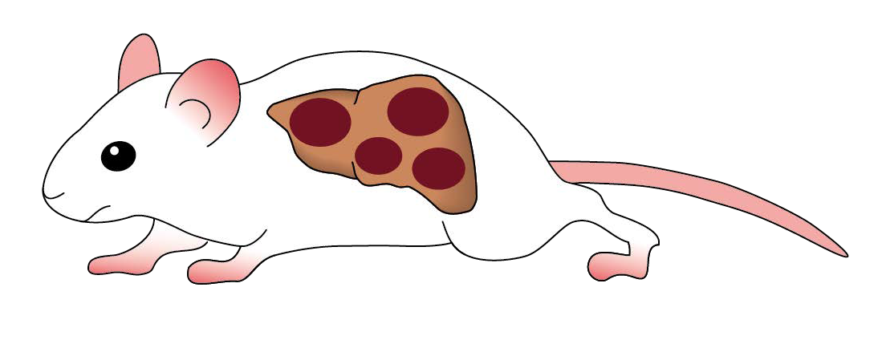
OS-103 The nucleoside analogue NITD008 strongly suppresses viral replication in immunodeficient humanized mice stably infected with the hepatitis E virus
Background & Aims
Methods
HEV is a clinically relevant infection with no currently approved antiviral treatment.
Off-label treatment with ribavirin is used in those that are immunosuppressed and suffering from chronic HEV.
Ribavirin can cause serious side effects, and a resistance could develop.
NIDT008 has shown efficacy in preclinical studies against a broad range of RNA viruses.
Immunodeficient human-liver chimeric mice
Infected with HEV via the co-housing fecal-oral route
(genotype 1)
6-8 weeks to achieve stable infection
Median HEV RNA viremia (1.5 x 107 IU/ml)
20 μg/g of NITD008 daily for up to 2 weeks
By oral gavage
Mock treatment
for up to 2 weeks
Vehicle
Aim: To evaluate the efficacy of NITD008 in vivo in human liver chimeric mice stably infected with HEV.
Mice sacrificed after 1-2 weeks of treatment
Subgroup oserved for 3-week rebound
qPCR performed on all mice at sacrifice
Viral changes determined by qPCR in faeces and blood
Intrahepatic analysis
Immunohistochemistry
Multiplex RNA-ISH
Notes:
Abbreviations: HEV = Hepatitis E virus; RNA-ISH = Multiplex RNA in situ hybridisation.
OS-103
The nucleoside analogue NITD008 strongly suppresses viral replication in immunodeficient humanized mice stably infected with the hepatitis E virus
Florian Hinte1, Tassilo Volz2, Annika Volmari3, Sven Pischke3, Marc Luetgehetmann4, Maura Dandri5
1I. Department of Internal Medicine, University Medical Center Hamburg-Eppendorf, German Center for Infection Research, Hamburg, Germany, 2I. Department of Internal Medicine, University Medical Center Hamburg-Eppendorf, 2. German Center for Infection Research (DZIF), Hamburg-Lübeck-Borstel-Riems, Hamburg, Germany, 3I. Department of Internal Medicine, University Medical Center Hamburg-Eppendorf, German Center for Infection Research (DZIF), Hamburg-Lübeck-Borstel-Riems, Hamburg, Germany, 4Department of Medical Microbiology, Virology and Hygiene, University Medical Center Hamburg-Eppendorf, German Center for Infection Research (DZIF), Hamburg-Lübeck-Borstel-Riems, Hamburg, Germany, 5I. Department of Internal Medicine, University Medical Center Hamburg-Eppendorf, Hamburg, Germany, German Center for Infection Research, Hamburg, Germany
Email: f.hinte@uke.de
Background and Aims: Hepatitis E virus (HEV) infection has an emerging clinical relevance for patients worldwide, but there is currently no approved antiviral therapy. For immunosuppressed people with chronic hepatitis E, off-label treatment with ribavirin is used in daily clinical practice, but ribavirin can cause serious side effects and resistance does emerge. Therefore, there is an urgent need for new and effective antiviral drugs against HEV infection. The adenosine nucleoside analogue NIDT008 is one such candidate that has been shown to be effective in preclinical studies against a broad range of RNA viruses. The aim of this study was to evaluate the efficacy of NITD008 in vivo in human liver chimeric mice stably infected with HEV.
Method: Immunodeficient human-liver chimeric mice were infected with hepatitis E virus (genotype 1) via the co-housing fecal-oral route. After a stable infection was achieved (6 - 8 weeks), median HEV RNA viremia was 1.5 x 107 IU/ml, mice received 20 μg/g of NITD008 by oral gavage daily for up to 2 weeks, while a control group received mock treatment. Viral changes were determined by qPCR in faeces and blood. Mice were sacrificed after 1 or 2 weeks of treatment, while a subgroup was observed for a 3-week rebound phase. Intrahepatic analysis including immunohistochemistry, multiplex RNA in situ hybridization (RNA-ISH) and qPCR was performed in all mice at sacrifice.
Results: NITD008 effectively reduced fecal HEV loads by up to 4log already in the first week of treatment, with some mice showing no detectable virus shedding. All mice had undetectable serum HEV titers (LLoQ) after 7 days, while vehicle-only controls showed no decrease in fecal and serum viral titers (median 7.7 x 106 IU/mL and 1 x 106 copies/ml, respectively). Intrahepatic analysis showed a 1.5 log reduction in HEV RNA/human housekeeper levels in treated mice compared to controls after 1 week of treatment and a 2.5 log reduction after 14 days of treatment. Consistent with the qPCR data, RNA-ISH analysis confirmed the presence of only a few weakly HEV-RNA-positive human hepatocytes in treated mice, whereas approximately 95% of human liver cells were strongly positive in control animals. Two weeks of NITD008 administration did not induce ALT elevation or significant weight loss in treated mice. Despite the strong reduction in HEV infection, HEV rebound was observed after 3 weeks of treatment cessation in this immunodeficient system.
Conclusion: This study demonstrates the efficacy and non-toxicity of the adenosine nucleoside analog NITD008 towards human hepatocytes after only 2 weeks of treatment in HEV infected human-chimeric mice. Longer treatment periods and/or combination regimens with ribavirin are needed to further optimize results and eventually achieve complete viral clearance even in the absence of a humoral immune response.

Slide 10
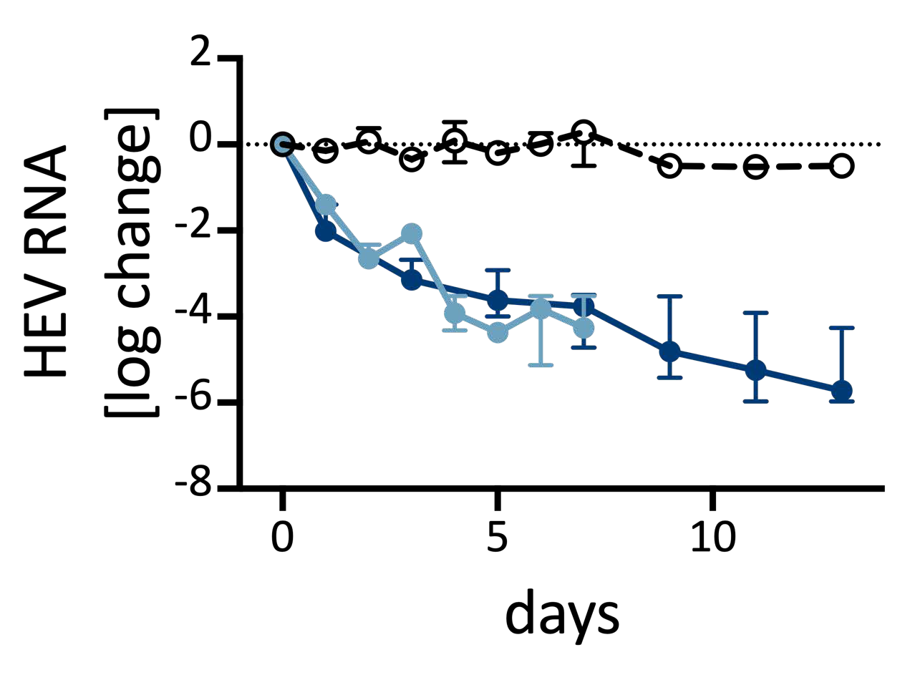
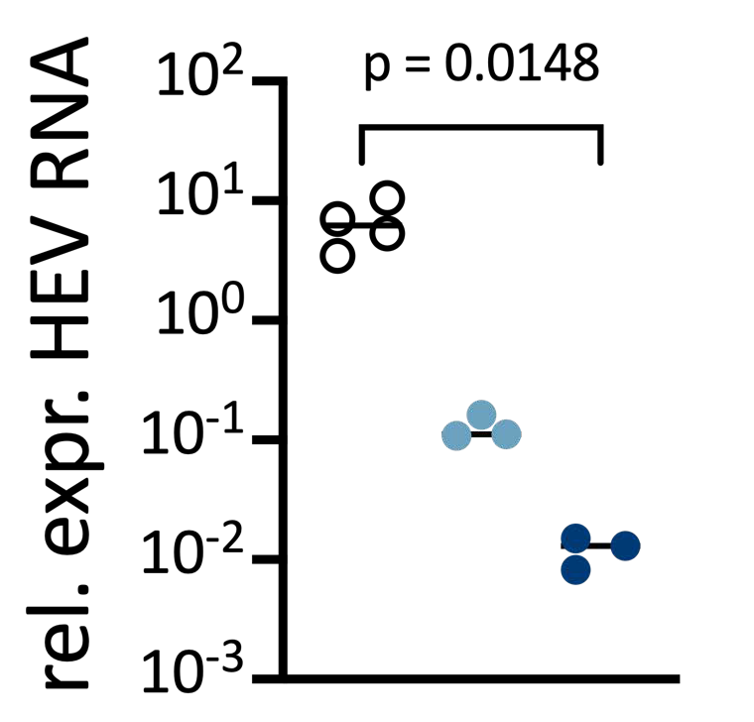
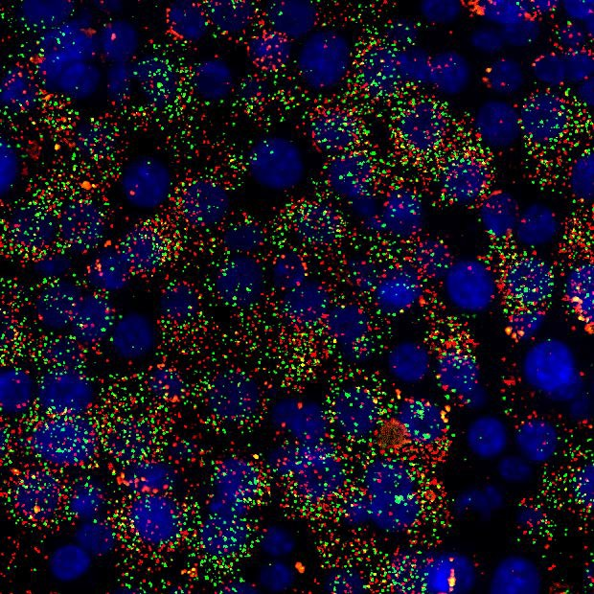
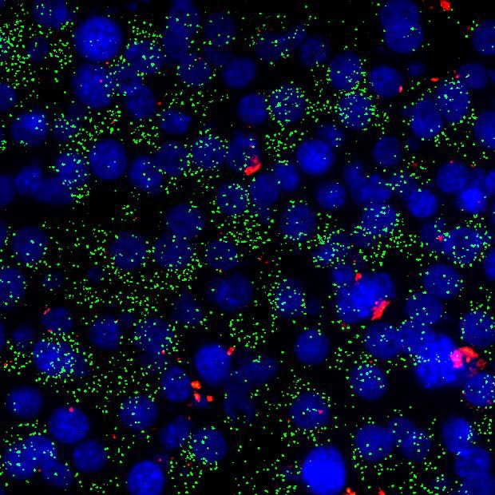
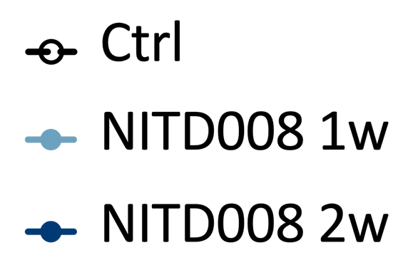
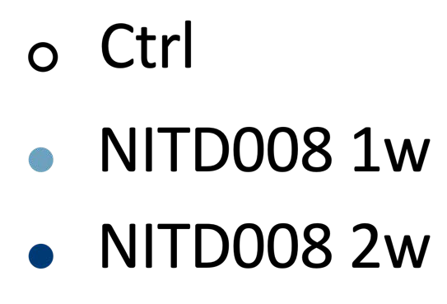
OS-103 The nucleoside analogue NITD008 strongly suppresses viral replication in immunodeficient humanized mice stably infected with the hepatitis E virus
Results
NITD008 effectively reduced fecal HEV loads by up to 4log after one week of treatment (with some mice showing no detectable virus shedding).
All mice had undetectable serum HEV titers (LLoQ) after 7 days. HEV RNA in the liver decreased 2.5 log in 2 weeks.
Two weeks of NITD008 administration did not induce ALT elevation or significant weight loss in treated mice.
Relative log changes of HEV RNA loads in faeces of mice receiving NITD008
Intrahepatic reduction of HEV RNA levels in treated mice compared to controls
Strongly reduced numbers of HEV- RNA-positive hepatocytes in treated mice.
control
NITD008 7d
human hepatocytes
HEV RNA
Conclusion
Here, the efficacy and non-toxicity of NITD008 towards human hepatocytes after only 2 weeks of treatment in HEV infected human-chimeric mice is demonstrated.
Longer treatment periods and/or combination regimens with ribavirin are needed to further optimise results and eventually achieve complete viral clearance even in the absence of a humoral immune response.
Notes:
Abbreviations: HEV = Hepatitis E virus; RNA-ISH = Multiplex RNA in situ hybridisation.
OS-103
The nucleoside analogue NITD008 strongly suppresses viral replication in immunodeficient humanized mice stably infected with the hepatitis E virus
Florian Hinte1, Tassilo Volz2, Annika Volmari3, Sven Pischke3, Marc Luetgehetmann4, Maura Dandri5
1I. Department of Internal Medicine, University Medical Center Hamburg-Eppendorf, German Center for Infection Research, Hamburg, Germany, 2I. Department of Internal Medicine, University Medical Center Hamburg-Eppendorf, 2. German Center for Infection Research (DZIF), Hamburg-Lübeck-Borstel-Riems, Hamburg, Germany, 3I. Department of Internal Medicine, University Medical Center Hamburg-Eppendorf, German Center for Infection Research (DZIF), Hamburg-Lübeck-Borstel-Riems, Hamburg, Germany, 4Department of Medical Microbiology, Virology and Hygiene, University Medical Center Hamburg-Eppendorf, German Center for Infection Research (DZIF), Hamburg-Lübeck-Borstel-Riems, Hamburg, Germany, 5I. Department of Internal Medicine, University Medical Center Hamburg-Eppendorf, Hamburg, Germany, German Center for Infection Research, Hamburg, Germany
Email: f.hinte@uke.de
Background and Aims: Hepatitis E virus (HEV) infection has an emerging clinical relevance for patients worldwide, but there is currently no approved antiviral therapy. For immunosuppressed people with chronic hepatitis E, off-label treatment with ribavirin is used in daily clinical practice, but ribavirin can cause serious side effects and resistance does emerge. Therefore, there is an urgent need for new and effective antiviral drugs against HEV infection. The adenosine nucleoside analogue NIDT008 is one such candidate that has been shown to be effective in preclinical studies against a broad range of RNA viruses. The aim of this study was to evaluate the efficacy of NITD008 in vivo in human liver chimeric mice stably infected with HEV.
Method: Immunodeficient human-liver chimeric mice were infected with hepatitis E virus (genotype 1) via the co-housing fecal-oral route. After a stable infection was achieved (6 - 8 weeks), median HEV RNA viremia was 1.5 x 107 IU/ml, mice received 20 μg/g of NITD008 by oral gavage daily for up to 2 weeks, while a control group received mock treatment. Viral changes were determined by qPCR in faeces and blood. Mice were sacrificed after 1 or 2 weeks of treatment, while a subgroup was observed for a 3-week rebound phase. Intrahepatic analysis including immunohistochemistry, multiplex RNA in situ hybridization (RNA-ISH) and qPCR was performed in all mice at sacrifice.
Results: NITD008 effectively reduced fecal HEV loads by up to 4log already in the first week of treatment, with some mice showing no detectable virus shedding. All mice had undetectable serum HEV titers (LLoQ) after 7 days, while vehicle-only controls showed no decrease in fecal and serum viral titers (median 7.7 x 106 IU/mL and 1 x 106 copies/ml, respectively). Intrahepatic analysis showed a 1.5 log reduction in HEV RNA/human housekeeper levels in treated mice compared to controls after 1 week of treatment and a 2.5 log reduction after 14 days of treatment. Consistent with the qPCR data, RNA-ISH analysis confirmed the presence of only a few weakly HEV-RNA-positive human hepatocytes in treated mice, whereas approximately 95% of human liver cells were strongly positive in control animals. Two weeks of NITD008 administration did not induce ALT elevation or significant weight loss in treated mice. Despite the strong reduction in HEV infection, HEV rebound was observed after 3 weeks of treatment cessation in this immunodeficient system.
Conclusion: This study demonstrates the efficacy and non-toxicity of the adenosine nucleoside analog NITD008 towards human hepatocytes after only 2 weeks of treatment in HEV infected human-chimeric mice. Longer treatment periods and/or combination regimens with ribavirin are needed to further optimize results and eventually achieve complete viral clearance even in the absence of a humoral immune response.

Slide 11
FRI-245-YI Hepatitis E virus entry requires the cholesterol transporter Niemann–Pick C1
Background & Aims
HEV is a significant global health concern with an estimated 20 million infections occurring annually There is no specific antiviral treatment available.
The lysosomal cholesterol transporter NPC1 has been shown to be implicated in the entry of different viruses, including Ebola virus and SARS-CoV-2, but it’s role in HEV infections remains unclear.
Aims:
To investigate the role of NPC1 during the HEV infectious cycle.
To evaluate the antiviral potential of the clinically approved NPC1 inhibitor Itraconazol.
Methods
Cell Culture model
Molecular analysis
Hepatocytes
KO Cell model
Robust HEV cell culture model infected with (non-) enveloped HEV.
Investigated the dose-dependent effect of Itraconazole and U18666A (two NPC1 inhibitors).
Requirement of NPC1 during the HEV life cycle evaluated in
Time-of-addition as well as subgenomic replicon assays.
Quantitative RNA fluorescence in situ hybridisation (RNA-FISH).
Antiviral effect of the NPC1 inhibitors evaluated in primary human hepatocytes (PHH)
siRNA-mediated knockdown
CRISPR/Cas9-mediated knock-out.
Notes:
Abbreviations: HEV = Hepatitis E virus.
FRI-245-YI
Hepatitis E virus entry requires the cholesterol transporter Niemann–Pick C1
Emely Richter1, Mara Klöhn1, VIktoria Kowalzick1, André Gömer1, Rebecca Fu2 3, Alexander Falkenhagen4, Viet Loan Dao Thi2 3, Reimar Johne4, Yannick Brüggemann1, Eike Steinmann1 5
1Department of Molecular and Medical Virology, Ruhr University Bochum, Bochum, Germany, 2Schaller Research Group, Department of Infectious Diseases and Virology, Heidelberg University Hospital, Heidelberg, Germany, 3Heidelberg Biosciences International Graduate School, Heidelberg University, Heidelberg, Germany, 4Department Biological Safety, German Federal Institute for Risk Assessment, Berlin, Germany, 5German Centre for Infection Research (DZIF), External Partner Site, Bochum, Germany
Email: emely.richter@rub.de
Background and Aims:
The hepatitis E virus (HEV) presents a significant global health concern with an estimated 20 million infections occurring annually, while no specific antiviral treatments are available. Our current understanding of the viral life cycle is limited, but it is essential for the development of novel antiviral strategies.
The lysosomal cholesterol transporter NPC1 has been shown to prevent the entry of different viruses, including Ebola virus and SARS-CoV-2. However, the role of the cholesterol transporter Niemann-Pick-C1 (NPC1) during HEV infections remains unclear. Here, we investigated the role of NPC1 during the HEV infectious cycle and evaluated the antiviral potential of the clinically approved NPC1 inhibitor Itraconazole.
Methods:
Using a robust HEV cell culture model, we investigated the dose-dependent effect of the two NPC1 inhibitors, Itraconazole and U18666 on the infection with (non-)enveloped HEV. In addition, we performed time-of-addition as well as subgenomic replicon assays to gain insights into the mode of action of the NPC1 inhibition. We further performed quantitative RNA fluorescence in situ hybridization (RNA-FISH) to localize HEV virions during NPC1 perturbation. The requirement of NPC1 during the HEV life cycle was further validated via siRNA-mediated knockdown and CRISPR/Cas9-mediated knockout. In addition, we evaluated the antiviral effect of the NPC1 inhibitors in primary human hepatocytes (PHH).
Results:
Both NPC1 inhibitors, Itraconazole and U18666A, lowered HEV infectivity at nanomolar efficacy in hepatoma cells. Consistent with this, siRNA-mediated knockdown of NPC1 and CRISPR/Cas9-mediated knockout lowered the susceptibility to infection with (non-)enveloped HEV. Time-of-addition experiments showed that the NPC1 inhibitors exert their antiviral effect during virus entry, without affecting viral replication, as observed by replicon assay. In agreement with this, we observed cholesterol accumulation and enlargement of lysosomal compartments upon NPC1 perturbation and a blockage of RNA trafficking and productive infection. In PHH, Itraconazole exhibited a potent effect in reducing the HEV infectivity.
Conclusion:
Overall, our data suggests that NPC1 plays a crucial role during the viral entry of HEV. Considering that the NPC1 inhibitor Itraconazole is clinically used in immunocompromised patients (unrelated to viral conditions), the pharmacological targeting of NPC1 might guide novel antiviral strategies against HEV infections in the future.

Slide 12
FRI-245-YI Hepatitis E virus entry requires the cholesterol transporter Niemann–Pick C1
Results
NPC1 inhibition reduces HEV infectivity
NPC1 perturbation disrupts intracellular trafficking
Itraconazole and U18666A lowered HEV infectivity at nanomolar concentrations in hepatoma cells.
Similar reduction observed in NPC1 knockdown/knockout (siRNA and CRISPR/Cas9) models.
Cholesterol accumulation + enlarged lysosomal
compartments.
RNA-FISH shows blocked RNA trafficking and reduced productive infection.
NPC1 is required during viral entry
Human hepatocyte validation
Time-of-addition experiments show effect occurs during entry, not replication.
Replicon assays confirm replication is unaffected.
Itraconazole exhibited potent antiviral activity in primary human hepatocytes (PHH).
Conclusion
These data suggest that NPC1 plays a crucial role during the viral entry of HEV. Considering that Itraconazole is already clinically used in immunocompromised patients, pharmacological targeting of NPC1 may represent a promising antiviral strategy against HEV infections.
Notes:
Abbreviations: HEV = Hepatitis E virus.
FRI-245-YI
Hepatitis E virus entry requires the cholesterol transporter Niemann–Pick C1
Emely Richter1, Mara Klöhn1, VIktoria Kowalzick1, André Gömer1, Rebecca Fu2 3, Alexander Falkenhagen4, Viet Loan Dao Thi2 3, Reimar Johne4, Yannick Brüggemann1, Eike Steinmann1 5
1Department of Molecular and Medical Virology, Ruhr University Bochum, Bochum, Germany, 2Schaller Research Group, Department of Infectious Diseases and Virology, Heidelberg University Hospital, Heidelberg, Germany, 3Heidelberg Biosciences International Graduate School, Heidelberg University, Heidelberg, Germany, 4Department Biological Safety, German Federal Institute for Risk Assessment, Berlin, Germany, 5German Centre for Infection Research (DZIF), External Partner Site, Bochum, Germany
Email: emely.richter@rub.de
Background and Aims:
The hepatitis E virus (HEV) presents a significant global health concern with an estimated 20 million infections occurring annually, while no specific antiviral treatments are available. Our current understanding of the viral life cycle is limited, but it is essential for the development of novel antiviral strategies.
The lysosomal cholesterol transporter NPC1 has been shown to prevent the entry of different viruses, including Ebola virus and SARS-CoV-2. However, the role of the cholesterol transporter Niemann-Pick-C1 (NPC1) during HEV infections remains unclear. Here, we investigated the role of NPC1 during the HEV infectious cycle and evaluated the antiviral potential of the clinically approved NPC1 inhibitor Itraconazole.
Methods:
Using a robust HEV cell culture model, we investigated the dose-dependent effect of the two NPC1 inhibitors, Itraconazole and U18666 on the infection with (non-)enveloped HEV. In addition, we performed time-of-addition as well as subgenomic replicon assays to gain insights into the mode of action of the NPC1 inhibition. We further performed quantitative RNA fluorescence in situ hybridization (RNA-FISH) to localize HEV virions during NPC1 perturbation. The requirement of NPC1 during the HEV life cycle was further validated via siRNA-mediated knockdown and CRISPR/Cas9-mediated knockout. In addition, we evaluated the antiviral effect of the NPC1 inhibitors in primary human hepatocytes (PHH).
Results:
Both NPC1 inhibitors, Itraconazole and U18666A, lowered HEV infectivity at nanomolar efficacy in hepatoma cells. Consistent with this, siRNA-mediated knockdown of NPC1 and CRISPR/Cas9-mediated knockout lowered the susceptibility to infection with (non-)enveloped HEV. Time-of-addition experiments showed that the NPC1 inhibitors exert their antiviral effect during virus entry, without affecting viral replication, as observed by replicon assay. In agreement with this, we observed cholesterol accumulation and enlargement of lysosomal compartments upon NPC1 perturbation and a blockage of RNA trafficking and productive infection. In PHH, Itraconazole exhibited a potent effect in reducing the HEV infectivity.
Conclusion:
Overall, our data suggests that NPC1 plays a crucial role during the viral entry of HEV. Considering that the NPC1 inhibitor Itraconazole is clinically used in immunocompromised patients (unrelated to viral conditions), the pharmacological targeting of NPC1 might guide novel antiviral strategies against HEV infections in the future.

Slide 13
Viral Hepatitis C
Clinical aspects including follow up after SVR

Slide 14
OS-100 Long term clinical outcomes in patients with chronic hepatitis C after direct-acting antiviral treatment: a prospective study
Background and Aims
Methods
Despite wide usage, the long-term clinical outcome following DAAs for hepatitis C virus infection has not been yet documented.
Since 2015, 14,495 patients have received treatment as part of the outreach program "Educate, Test and Treat" among 73 villages in Egypt.
Aim: To report the incidence of decompensated cirrhosis, hepatocellular cancer, and all-cause mortality in addition to fibrosis changes among patients received direct-acting antiviral therapy over a 10-year period.
Prospective study
Patients enrolled from 12 villages in Egypt who received DAAs in the last 10 years.
Exclusion criteria:
History of decompensated cirrhosis
Hepatocellular carcinoma
Liver transplantation
Chronic hepatitis B
Interferon-ribavirin treatment
Liver fibrosis
Changes detected by FibroScan® or FIB-4 and FIB-6
Notes:
Abbreviations: DAAs = Direct Antivirals; CHC = Chronic hepatitis C; CHB =Chronic hepatitis B.
OS-100
Long term clinical outcomes in patients with chronic hepatitis C after direct-acting antiviral treatment: a prospective study
Riham Soliman1 2, ayman hassan2, Nabiel Mikhail3, Nada El-domiaty4, Ahmed Farahat5, Gamal Shiha2 6
1Tropical Medicine Department, Faculty of Medicine, Port Said University, Egypt, Port Said, Egypt, 2Egyptian Liver Research Institute and Hospital (ELRIAH), Sherbin, El Mansoura, Egypt, Sherbin, Egypt, 3Egyptian Liver Research Institute & Hospital (ELRIAH), shirbin, Egypt, 4Tropical Medicine Dept., Faculty of Medicine, Helwan University, Helwan, Egypt, 5Egyptian Liver Research Institute and Hospital, Mansoura, Egypt, 6Hepatology and Gastroenterology Unit, Internal Medicine Department, Faculty of Medicine, Mansoura University, Egypt, Mansoura, Egypt
Email: rimo1979@gmail.com
Background and Aims: The long-term clinical outcome following direct acting antivirals for hepatitis C virus infection has not been yet documented despite the fact that they have been widely used. A total of 14,495 CHC patients received treatment in outreach program "Educate, Test and Treat" among 73 villages in Egypt since 2015. Our aim was to report the incidence of decompensated cirrhosis, hepatocellular cancer, and all-cause mortality in addition to fibrosis changes among patients received direct-acting antiviral therapy over a 10-years period.
Method: We conducted a prospective study including patients who received DAAs since 10 years enrolled from eleven Egyptian villages up till now. Patients with a history of decompensated cirrhosis, hepatocellular cancer, liver transplantation, or chronic hepatitis B were not included in our analysis, nor were those receiving interferon-ribavirin treatment. Our primary aim was to report the incidence of decompensated cirrhosis, hepatocellular cancer, and all-cause mortality. Secondary objective was detection of liver fibrosis changes , by FibroScan or FIB-4 and FIB-6.
Results: 1603 patients were eligible for the study, with available follow-up information and were included in analyses. Median follow-up was 98.0 months (IQR 71.0–105.0). During follow-up, 377 patients died, 32 reported decompensated cirrhosis and 41 reported hepatocellular carcinoma. Exposure to direct-acting antivirals was associated with all-cause mortality rate of 3.42/100 py (95% CI 3.08-3.77), decompensation of 0.26/100 py (95% CI 0.18-0.36), and hepatocellular carcinoma of 0.51/100 py (95% CI 0.11-0.25). In cirrhotic patients, 17% showed reversal of cirrhosis, 19.1% showed fibrosis regression while 63.8% remained stationary. F3 patients showed reversal of fibrosis in 44.4%, 19.8% showed fibrosis regression and 19.8% remained stationary while 16.0% progressed to F4.
Conclusion: This is the first study to document the long-term outcomes for patients treated with direct-acting antivirals (DAAs) for hepatitis C virus infection in Egyptian patients with
genotype 4. Our findings demonstrate that DAAs are associated with a decreased risk of decompensation and hepatocellular carcinoma, and often lead to improvements in liver fibrosis. Further studies involving different ethnicities and genotypes are needed.

Slide 15
OS-100 Long term clinical outcomes in patients with chronic hepatitis C after direct-acting antiviral treatment: a prospective study
Results
Patient overview
Fibrosis and cirrhosis outcomes
3328 patients eligible for study
Median follow-up: 98 months (IQR 71.0–105.0)
593 patients died during study
281 reported decompensated cirrhosis
271 reported HCC
In patients with cirrhosis:
27.3% showed reversal of cirrhosis
20.2% showed fibrosis regression
52.2% remained stationary
In all patients:
Outcomes Associated with DAA Exposure
Outcome | % of patients
Reversal of fibrosis | 11.9%
Fibrosis regression | 17.8%
Stationary fibrosis | 50.5%
Progression (F4) | 19.8%
Outcome | Rate per 100 py | 95% CI
All-cause mortality | 3.42 | 3.08–3.77
Decompensated cirrhosis | 0.26 | 0.18–0.36
Hepatocellular carcinoma | 0.51 | 0.11–0.25
Conclusion
These findings demonstrate that DAAs are associated with a decreased risk of decompensation and hepatocellular carcinoma and often lead to improvements in liver fibrosis.
Notes:
Abbreviations: DAAs = Direct Antivirals; CHC = Chronic hepatitis C; CHB =Chronic hepatitis B.
OS-100
Long term clinical outcomes in patients with chronic hepatitis C after direct-acting antiviral treatment: a prospective study
Riham Soliman1 2, ayman hassan2, Nabiel Mikhail3, Nada El-domiaty4, Ahmed Farahat5, Gamal Shiha2 6
1Tropical Medicine Department, Faculty of Medicine, Port Said University, Egypt, Port Said, Egypt, 2Egyptian Liver Research Institute and Hospital (ELRIAH), Sherbin, El Mansoura, Egypt, Sherbin, Egypt, 3Egyptian Liver Research Institute & Hospital (ELRIAH), shirbin, Egypt, 4Tropical Medicine Dept., Faculty of Medicine, Helwan University, Helwan, Egypt, 5Egyptian Liver Research Institute and Hospital, Mansoura, Egypt, 6Hepatology and Gastroenterology Unit, Internal Medicine Department, Faculty of Medicine, Mansoura University, Egypt, Mansoura, Egypt
Email: rimo1979@gmail.com
Background and Aims: The long-term clinical outcome following direct acting antivirals for hepatitis C virus infection has not been yet documented despite the fact that they have been widely used. A total of 14,495 CHC patients received treatment in outreach program "Educate, Test and Treat" among 73 villages in Egypt since 2015. Our aim was to report the incidence of decompensated cirrhosis, hepatocellular cancer, and all-cause mortality in addition to fibrosis changes among patients received direct-acting antiviral therapy over a 10-years period.
Method: We conducted a prospective study including patients who received DAAs since 10 years enrolled from eleven Egyptian villages up till now. Patients with a history of decompensated cirrhosis, hepatocellular cancer, liver transplantation, or chronic hepatitis B were not included in our analysis, nor were those receiving interferon-ribavirin treatment. Our primary aim was to report the incidence of decompensated cirrhosis, hepatocellular cancer, and all-cause mortality. Secondary objective was detection of liver fibrosis changes , by FibroScan or FIB-4 and FIB-6.
Results: 1603 patients were eligible for the study, with available follow-up information and were included in analyses. Median follow-up was 98.0 months (IQR 71.0–105.0). During follow-up, 377 patients died, 32 reported decompensated cirrhosis and 41 reported hepatocellular carcinoma. Exposure to direct-acting antivirals was associated with all-cause mortality rate of 3.42/100 py (95% CI 3.08-3.77), decompensation of 0.26/100 py (95% CI 0.18-0.36), and hepatocellular carcinoma of 0.51/100 py (95% CI 0.11-0.25). In cirrhotic patients, 17% showed reversal of cirrhosis, 19.1% showed fibrosis regression while 63.8% remained stationary. F3 patients showed reversal of fibrosis in 44.4%, 19.8% showed fibrosis regression and 19.8% remained stationary while 16.0% progressed to F4.
Conclusion: This is the first study to document the long-term outcomes for patients treated with direct-acting antivirals (DAAs) for hepatitis C virus infection in Egyptian patients with
genotype 4. Our findings demonstrate that DAAs are associated with a decreased risk of decompensation and hepatocellular carcinoma, and often lead to improvements in liver fibrosis. Further studies involving different ethnicities and genotypes are needed.

Slide 16
Viral Hepatitis B and D
New therapies, unapproved therapies or strategies

Slide 17
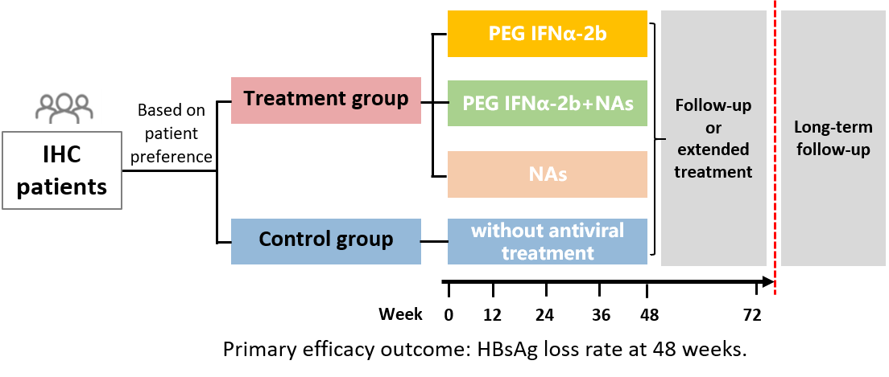
THU-240 30% of inactive HBsAg carriers achieved clinical cure at 48 weeks with Pegylated Interferon alpha-2b therapy: a multicenter real-world study (STARHB Project in China)- 2.5 years data update
Background and Aims
The STARHB Project is a multicenter real-world study in China focussed on the functional cure of IHC, aiming to onboard approximately 25,000 patients (ChiCTR2200061541).
Aim: To investigate the efficacy and safety of achieving functional cure (HBsAg loss) using PEG IFNα-2b treatment in IHC.
Methods
Notes:
Abbreviations: STARHB = The STUDY ON TREATMENT FOR INACTIVE CARRIERS OF HEPATITIS B; PEG IFNα-2b = Pegylated Interferon alpha-2b; IHC = inactive HBsAg carriers = NAs: nucleos(t)ide analogues.
THU-240
30% of inactive HBsAg carriers achieved clinical cure at 48 weeks with Pegylated Interferon alpha-2b therapy: a multicenter real-world study (STARHB Project in China)- 2.5 years data update
Shan Ren1, Jing Zhao1, Sujun Zheng1, Bingliang Lin2, Yongfang Jiang3, Faqing Ruan4, Yan Huang5, yilan zeng6, Jiawei Geng7, Haifang Cao8, Wenhua Zhang9, Ying Guo10, Xiaorong Mao11, Zhiliang Gao2, Tianyuan Shi12, YueYong Zhu13, Zu-Jiang Yu14, Xiaoping Wu15, Qing Mao16, Xiulan Xue17, Yingli He18, Jia Shang19, Shuangsuo Dang20, Haidong Zhao21, Rongshan Fan22, Jiangling Yang23, Jainqi Lian24, Haibing Gao25, Xin-Yue Chen1
1Beijing You'an Hospital, Capital Medical University, Beijing, China, 2The third affiliated hospital of Sun Yat-sen university, Guangzhou, China, 3The Second Xiangya Hospital of Central South University, Changsha, China, 4Xiamen Hospital of Traditional Chinese Medicine, Xiamen, China, 5Xiangya Hospital Central South University, Changsha, China, 6Public Health Clinical Center of Chengdu, Chengdu, China, 7The First People's Hospital of Yunnan Province, Kunming, China, 8The 4th People's Hospital of Qinghai Province, Xining, China, 9Gansu Wuwei Tumour Hospital, Wuwei, China, 10The third people's Hospital of Taiyuan, Taiyuan, China, 11The first hospital of lanzhou university, Lanhzou, China, 12The second hospital of longyan, Longyan, China, 13The First Affiliated Hospital of Fujian Medical University, Fuzhou, China, 14The First Affiliated Hospital of Zhengzhou University, Zhengzhou, China, 15The First Affiliated Hospital of Nanchang University, Nanchang, China, 16The southwest hospital of AMU, Chongqing, China, 17The First Affiliated Hospital of Xiamen University, Xiamen, China, 18The First Affiliated Hospital of Xi'an JiaoTong University, Xi'an, China, 19People's Hospital of Henan province, Zhengzhou, China, 20The Second Affiliated Hospital of Xi'an Jiaotong University, Xi'an, China, 21Xiamen Changgeng Hospital Co, Ltd, Xiamen, China, 22Shenzhen Hospital of Integrated Traditional Chinese and Western Medicine, Shenzhen, China, 23Ningbo Beilun District Traditional Chinese Medicine Hospital, Ningbo, China, 24The Second Affiliated Hospital of Air Force Medical University, Xi'an, China, 25Mengchao Hepatobiliary Hospital OF Fujian Medical University, Fuzhou, China
Email: chenxydoc@163.com
Background and Aims: This study aimed to investigate the efficacy and safety of achieving functional cure (HBsAg loss) using Pegylated Interferon alpha-2b (PEG IFNα-2b) treatment in inactive HBsAg carriers (IHC).
Method: The STARHB Project (The STUDY ON TREATMENT FOR INACTIVE CARRIERS OF HEPATITIS B) is a multicenter real-world study in China focused on the functional cure of IHC, aiming to onboard approximately 25,000 patients (ChiCTR2200061541). Based on patient preferences, participants were assigned to a control group (without antiviral treatment) or treatment groups (NAs group and PEG IFNα-2b ± NAs group). The basic treatment duration was 48 weeks, extendable to 96 weeks as needed.
Results: As of Nov. 2024, 15,070 individuals were screened, and 10,894 eligible IHC patients were included in the mITT population baseline analysis. This cohort was 64.9% male with a mean age of 43 years; 6.3% were under 30 years old, and 41.5% had fatty liver. The mean HBsAg level was 223 IU/ml, with 81.8% below 500 IU/ml. The mean HBV DNA level was 220 IU/ml, with 58.5% having undetectable HBV DNA at baseline. The mean ALT was 22 U/L. Liver biopsies were performed on 60 patients at baseline, with 33.3% showing significant liver necroinflammation and/or fibrosis (≥ G2 and/or ≥ S2).
At present, 729 patients have completed the 48-week follow-up. In the control group (n=11), 4 achieved virological response (VR), with 1 achieved HBsAg loss. In the NAs group, the VR rate at 48 weeks was 100% (17/17), with 1 achieved HBsAg loss. Among those treated with PEG IFNα-2b ± NAs, the VR rate at 48 weeks was 91.01% (638/701), with an HBsAg loss rate of 30% (210/701). ROC analysis indicated that baseline HBsAg levels, 12-week and 24-week HBsAg levels, and 12-week AST levels could predict HBsAg loss at 48 weeks.
Conclusion: PEG IFNα-2b therapy can effectively achieve functional cure in IHC patients, with a 48-week HBsAg loss rate of 30%. Lower baseline, 12-week, and 24-week HBsAg levels, along with higher 12-week AST levels, are predictors of functional cure at 48 weeks. Thus, the IHC population is a favorable group for pursuing clinical cure for hepatitis B.

Slide 18
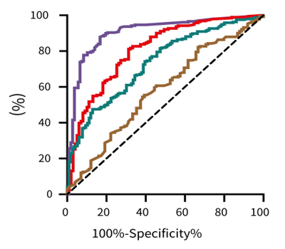
THU-240 30% of inactive HBsAg carriers achieved clinical cure at 48 weeks with Pegylated Interferon alpha-2b therapy: a multicenter real-world study (STARHB Project in China)- 2.5 years data update
Results
As of November 2024, 729 patients have finished the 48-week follow-up.
HBsAg loss
Predictors of response
Group | HBsAg loss at 48 weeks
Control | 1/11
NAs | 1/17
PEG IFNα-2b ± NAs | 210/701 (30%)
Baseline HBsAg levels, 12-week & 24-week HBsAg levels, and 12-week AST levels could predict HBsAg loss at 48 weeks.
 | AUROC | P | Cut-off | Sensitivity (%) | Specificity (%)
Baseline HBsAg | 0.734 (0.681-0.788) | <0.001 | 224.2 | 47.54 | 87.07
12W HBsAg | 0.808 (0.754-0.861) | <0.001 | 4.04 | 81.15 | 68.69
24W HBsAg | 0.906 (0.869-0.943) | <0.001 | 0.77 | 87.92 | 83.18
12W AST | 0.581 (0.511-0.650) | 0.02 | 46.4 | 55.5 | 60.61
PEG IFNα-2b ± NAs =
30% HBsAg loss at 48 weeks.
Liver biopsies
Performed on 60 patients at baseline
33.3% showed significant liver necroinflammation and/or fibrosis (≥ G2 and/or ≥ S2).
Conclusion
PEG IFNα-2b therapy can effectively achieve functional cure in IHC patients, (48-week HBsAg loss rate of 30%)
Lower baseline, 12-week, and 24-week HBsAg levels, along with higher 12-week AST levels, are predictors of functional cure at 48 weeks.
IHC population is a favorable group for pursuing clinical cure for hepatitis B.
Notes:
Abbreviations: STARHB = The STUDY ON TREATMENT FOR INACTIVE CARRIERS OF HEPATITIS B; PEG IFNα-2b = Pegylated Interferon alpha-2b; IHC = inactive HBsAg carriers = NAs: nucleos(t)ide analogues.
THU-240
30% of inactive HBsAg carriers achieved clinical cure at 48 weeks with Pegylated Interferon alpha-2b therapy: a multicenter real-world study (STARHB Project in China)- 2.5 years data update
Shan Ren1, Jing Zhao1, Sujun Zheng1, Bingliang Lin2, Yongfang Jiang3, Faqing Ruan4, Yan Huang5, yilan zeng6, Jiawei Geng7, Haifang Cao8, Wenhua Zhang9, Ying Guo10, Xiaorong Mao11, Zhiliang Gao2, Tianyuan Shi12, YueYong Zhu13, Zu-Jiang Yu14, Xiaoping Wu15, Qing Mao16, Xiulan Xue17, Yingli He18, Jia Shang19, Shuangsuo Dang20, Haidong Zhao21, Rongshan Fan22, Jiangling Yang23, Jainqi Lian24, Haibing Gao25, Xin-Yue Chen1
1Beijing You'an Hospital, Capital Medical University, Beijing, China, 2The third affiliated hospital of Sun Yat-sen university, Guangzhou, China, 3The Second Xiangya Hospital of Central South University, Changsha, China, 4Xiamen Hospital of Traditional Chinese Medicine, Xiamen, China, 5Xiangya Hospital Central South University, Changsha, China, 6Public Health Clinical Center of Chengdu, Chengdu, China, 7The First People's Hospital of Yunnan Province, Kunming, China, 8The 4th People's Hospital of Qinghai Province, Xining, China, 9Gansu Wuwei Tumour Hospital, Wuwei, China, 10The third people's Hospital of Taiyuan, Taiyuan, China, 11The first hospital of lanzhou university, Lanhzou, China, 12The second hospital of longyan, Longyan, China, 13The First Affiliated Hospital of Fujian Medical University, Fuzhou, China, 14The First Affiliated Hospital of Zhengzhou University, Zhengzhou, China, 15The First Affiliated Hospital of Nanchang University, Nanchang, China, 16The southwest hospital of AMU, Chongqing, China, 17The First Affiliated Hospital of Xiamen University, Xiamen, China, 18The First Affiliated Hospital of Xi'an JiaoTong University, Xi'an, China, 19People's Hospital of Henan province, Zhengzhou, China, 20The Second Affiliated Hospital of Xi'an Jiaotong University, Xi'an, China, 21Xiamen Changgeng Hospital Co, Ltd, Xiamen, China, 22Shenzhen Hospital of Integrated Traditional Chinese and Western Medicine, Shenzhen, China, 23Ningbo Beilun District Traditional Chinese Medicine Hospital, Ningbo, China, 24The Second Affiliated Hospital of Air Force Medical University, Xi'an, China, 25Mengchao Hepatobiliary Hospital OF Fujian Medical University, Fuzhou, China
Email: chenxydoc@163.com
Background and Aims: This study aimed to investigate the efficacy and safety of achieving functional cure (HBsAg loss) using Pegylated Interferon alpha-2b (PEG IFNα-2b) treatment in inactive HBsAg carriers (IHC).
Method: The STARHB Project (The STUDY ON TREATMENT FOR INACTIVE CARRIERS OF HEPATITIS B) is a multicenter real-world study in China focused on the functional cure of IHC, aiming to onboard approximately 25,000 patients (ChiCTR2200061541). Based on patient preferences, participants were assigned to a control group (without antiviral treatment) or treatment groups (NAs group and PEG IFNα-2b ± NAs group). The basic treatment duration was 48 weeks, extendable to 96 weeks as needed.
Results: As of Nov. 2024, 15,070 individuals were screened, and 10,894 eligible IHC patients were included in the mITT population baseline analysis. This cohort was 64.9% male with a mean age of 43 years; 6.3% were under 30 years old, and 41.5% had fatty liver. The mean HBsAg level was 223 IU/ml, with 81.8% below 500 IU/ml. The mean HBV DNA level was 220 IU/ml, with 58.5% having undetectable HBV DNA at baseline. The mean ALT was 22 U/L. Liver biopsies were performed on 60 patients at baseline, with 33.3% showing significant liver necroinflammation and/or fibrosis (≥ G2 and/or ≥ S2).
At present, 729 patients have completed the 48-week follow-up. In the control group (n=11), 4 achieved virological response (VR), with 1 achieved HBsAg loss. In the NAs group, the VR rate at 48 weeks was 100% (17/17), with 1 achieved HBsAg loss. Among those treated with PEG IFNα-2b ± NAs, the VR rate at 48 weeks was 91.01% (638/701), with an HBsAg loss rate of 30% (210/701). ROC analysis indicated that baseline HBsAg levels, 12-week and 24-week HBsAg levels, and 12-week AST levels could predict HBsAg loss at 48 weeks.
Conclusion: PEG IFNα-2b therapy can effectively achieve functional cure in IHC patients, with a 48-week HBsAg loss rate of 30%. Lower baseline, 12-week, and 24-week HBsAg levels, along with higher 12-week AST levels, are predictors of functional cure at 48 weeks. Thus, the IHC population is a favorable group for pursuing clinical cure for hepatitis B.

Slide 19
Background and Aims
GS-010 Outcomes of 48 weeks of therapy and subsequent 24-week post-treatment period with tobevibart (VIR-3434) and elebsiran (VIR-2218) with or without pegylated interferon alfa-2a in chronic hepatitis B virus infection. Findings from the MARCH study
Tobevibart and elebsiran with or without IFN are under evaluation in participants with chronic hepatitis B virus (HBV) infection in the Phase 2 MARCH study.
Tobevibart is an investigational engineered human monoclonal antibody targeting the conserved antigenic loop of HBsAg. Elebsiran is an investigational siRNA targeting the HBx region of the HBV genome.
Aim: To present available end of treatment (EOT) data after 48 weeks of therapy.
Methods
Participants with chronic HBV infections on NRTIs were treated with:
Key Endpoints
Treatment-emergent adverse events (TEAEs).
HBsAg seroclearance (< 0.05 IU/mL) at EOT.
FCR at 24 weeks post-EOT in participants with HBsAg seroclearance who had discontinued NRTI treatment.
Tobevibart
N = 20
Tobevibart + Elebsiran
N = 51
Tobevibart + Elebsiran + IFN n = 27
Tobevibart: 300mg every 4 weeks, Elebsiran: 200mg every 4 weeks, IFN: 180 μg weekly
Notes:
Abbreviations: Small interfering ribonucleic acid = siRNA; Tobevibart = VIR-3434; Elebsiran = VIR-2218; Pegylated interferon alfa-2a =IFN ; Q4W = monthly; NRTIs = nucleos(t)ide-reverse transcriptase inhibitors.
GS-010
Outcomes of 48 weeks of therapy and subsequent 24-week post-treatment period with tobevibart (VIR-3434) and elebsiran (VIR-2218) with or without pegylated interferon alfa-2a in chronic hepatitis B virus infection. Findings from the MARCH study
Edward J. Gane1, Kosh Agarwal2, Jeong Heo3, Alina Jucov4 5, Young-Suk Lim6, Anca Streinu-Cercel7, Grace Lai-Hung Wong8, Ki Tae yoon9, Andre Arizpe10, Sergio Parra10, Keith Boundy10, Shuli Yu10, Li Wang10, Karen Tracy10, Andrea Cathcart10, Todd Correll10, Carey Hwang10, Man-Fung Yuen11
1University of Auckland and New Zealand Clinical Research, Auckland, New Zealand, 2Institute of Liver Studies, King's College Hospital, London, United Kingdom, 3Department of Internal Medicine, College of Medicine, Pusan National University, Busan, Korea, Rep. of South, 4Arensia Exploratory Medicine GmbH, Düsseldorf, Germany, 5Nicolae Testemițanu State University of Medicine and Pharmacy, Chişinău, Moldova, 6Department of Gastroenterology, Liver Center, Asan Medical Center, University of Ulsan College of Medicine, Seoul, Korea, Rep. of South, 7National Institute for Infectious Diseases Matei Bals, Carol Davila University of Pharmacy and Medicine, Bucharest, Romania, 8The Chinese University of Hong Kong, Hong Kong, China, 9Pusan National University Yangsan Hospital, Pusan National University College of Medicine, Yangsan, Korea, Rep. of South, 10Vir Biotechnology, Inc., San Francisco, United States, 11State Key Laboratory of Liver Research, University of Hong Kong, Hong Kong, China
Email: edgane@adhb.govt.nz
Background and Aims: Tobevibart (VIR-3434) and elebsiran (VIR-2218) with or without pegylated interferon alfa-2a (IFN) are under evaluation in participants with chronic hepatitis B virus (HBV) infection in the Phase 2 MARCH study. Tobevibart is an investigational engineered human monoclonal antibody targeting the conserved antigenic loop of HBsAg, while elebsiran is an investigational small interfering ribonucleic acid (siRNA) targeting the HBx region of the HBV genome. Here, we present available end of treatment (EOT) data after 48 weeks of therapy, and 24 weeks post-EOT functional cure rate (FCR) results will be available at time of presentation.
Method: Participants with chronic HBV infection on nucleos(t)ide-reverse transcriptase inhibitors (NRTIs) received 44-48 weeks of tobevibart alone, a combination of tobevibart and elebsiran, or a regimen including tobevibart, elebsiran, and IFN. Tobevibart, elebsiran, and IFN were administered subcutaneously at 300 mg every 4 weeks (Q4W), 200 mg Q4W, and 180 μg weekly, respectively. Key endpoints included the evaluation of treatment-emergent adverse events (TEAEs), HBsAg seroclearance (< 0.05 IU/mL) at the EOT, and FCR at 24 weeks post-EOT in participants with HBsAg seroclearance who had discontinued NRTI treatment.
Results: EOT results for all participants in the tobevibart (n = 20) and tobevibart + elebsiran (n = 51) cohorts, and in 27 out of 50 participants in the tobevibart + elebsiran + IFN cohort were previously reported. HBsAg seroclearance rates at EOT were 0/20 (0%), 8/51 (15.7%), and 6/27 (22.2%) for the tobevibart, tobevibart + elebsiran, and tobevibart + elebsiran + IFN cohorts, respectively. Higher HBsAg seroclearance rates were observed in participants with lower baseline HBsAg. Specifically, in participants with baseline HBsAg < 1000 IU/mL, seroclearance at EOT was observed in 7/18 (38.9%) in the tobevibart + elebsiran cohort and 5/11 (45.5%) in the tobevibart + elebsiran + IFN cohort. TEAEs were predominantly grade 1-2, with grade ≥ 3 TEAEs observed in 0, 2 (3.9%), and 9 (33.3%) participants in the respective groups. Serious TEAEs related to study drugs were reported only in the tobevibart + elebsiran + IFN group, including one case of leukopenia attributed to IFN and one case of hepatitis attributed to all three study drugs; both events improved without lasting consequences.
Follow-up is ongoing, and FCR results at 24 weeks post EOT for participants with HBsAg seroclearance who have discontinued NRTIs will be presented.
Conclusion: The combination tobevibart and elebsiran, with or without the addition of IFN, can achieve HBsAg loss, especially in participants presenting with lower baseline HBsAg. TEAEs were predominantly mild to moderate, and no new safety concerns emerged. These positive outcomes and the overall risk-benefit profile are supportive of the further clinical development in treating chronic HBV infection.

Slide 20
GS-010 Outcomes of 48 weeks of therapy and subsequent 24-week post-treatment period with tobevibart (VIR-3434) and elebsiran (VIR-2218) with or without pegylated interferon alfa-2a in chronic hepatitis B virus infection. Findings from the MARCH study
Results
HBsAg clearance:
TEAEs:
Higher HBsAg seroclearance rates were observed in participants with lower baseline HBsAg.
Serious TEAEs only reported in the tobevibart + elebsiran + IFN group (one case of leukopenia due to IFN and one case of hepatitis attributed to all three drugs; both events improved without lasting consequences.
 | Tobevibart (n = 20) | Tobevibart + Elebsiran (n = 51) | Tobevibart + Elebsiran + IFN (n = 27)
HBsAg seroclearance | 0.0% | 15.70% | 22.20%
HBsAg seroclearance Baseline HBsAg < 1000 IU/mL |  | 38.9% | 45.5%
Tobevibart | Tobevibart + Elebsiran | Tobevibart + Elebsiran + IFN
0 | 4% | 33.3%
TEAEs (> grade 3)
Conclusion
Combination of tobevibart and elebsiran, with or without the addition of IFN, can achieve HBsAg loss.
TEAEs were predominantly mild to moderate, and no new safety concerns emerged.
These positive outcomes and the overall risk-benefit profile are supportive of the further clinical development in treating chronic HBV infection.
Follow-up for functional cure response (FCR) at 24 weeks post-EOT is ongoing.
Notes:
Abbreviations: Small interfering ribonucleic acid = siRNA; Tobevibart = VIR-3434; Elebsiran = VIR-2218; Pegylated interferon alfa-2a =IFN ; Q4W = monthly; NRTIs = nucleos(t)ide-reverse transcriptase inhibitors.
GS-010
Outcomes of 48 weeks of therapy and subsequent 24-week post-treatment period with tobevibart (VIR-3434) and elebsiran (VIR-2218) with or without pegylated interferon alfa-2a in chronic hepatitis B virus infection. Findings from the MARCH study
Edward J. Gane1, Kosh Agarwal2, Jeong Heo3, Alina Jucov4 5, Young-Suk Lim6, Anca Streinu-Cercel7, Grace Lai-Hung Wong8, Ki Tae yoon9, Andre Arizpe10, Sergio Parra10, Keith Boundy10, Shuli Yu10, Li Wang10, Karen Tracy10, Andrea Cathcart10, Todd Correll10, Carey Hwang10, Man-Fung Yuen11
1University of Auckland and New Zealand Clinical Research, Auckland, New Zealand, 2Institute of Liver Studies, King's College Hospital, London, United Kingdom, 3Department of Internal Medicine, College of Medicine, Pusan National University, Busan, Korea, Rep. of South, 4Arensia Exploratory Medicine GmbH, Düsseldorf, Germany, 5Nicolae Testemițanu State University of Medicine and Pharmacy, Chişinău, Moldova, 6Department of Gastroenterology, Liver Center, Asan Medical Center, University of Ulsan College of Medicine, Seoul, Korea, Rep. of South, 7National Institute for Infectious Diseases Matei Bals, Carol Davila University of Pharmacy and Medicine, Bucharest, Romania, 8The Chinese University of Hong Kong, Hong Kong, China, 9Pusan National University Yangsan Hospital, Pusan National University College of Medicine, Yangsan, Korea, Rep. of South, 10Vir Biotechnology, Inc., San Francisco, United States, 11State Key Laboratory of Liver Research, University of Hong Kong, Hong Kong, China
Email: edgane@adhb.govt.nz
Background and Aims: Tobevibart (VIR-3434) and elebsiran (VIR-2218) with or without pegylated interferon alfa-2a (IFN) are under evaluation in participants with chronic hepatitis B virus (HBV) infection in the Phase 2 MARCH study. Tobevibart is an investigational engineered human monoclonal antibody targeting the conserved antigenic loop of HBsAg, while elebsiran is an investigational small interfering ribonucleic acid (siRNA) targeting the HBx region of the HBV genome. Here, we present available end of treatment (EOT) data after 48 weeks of therapy, and 24 weeks post-EOT functional cure rate (FCR) results will be available at time of presentation.
Method: Participants with chronic HBV infection on nucleos(t)ide-reverse transcriptase inhibitors (NRTIs) received 44-48 weeks of tobevibart alone, a combination of tobevibart and elebsiran, or a regimen including tobevibart, elebsiran, and IFN. Tobevibart, elebsiran, and IFN were administered subcutaneously at 300 mg every 4 weeks (Q4W), 200 mg Q4W, and 180 μg weekly, respectively. Key endpoints included the evaluation of treatment-emergent adverse events (TEAEs), HBsAg seroclearance (< 0.05 IU/mL) at the EOT, and FCR at 24 weeks post-EOT in participants with HBsAg seroclearance who had discontinued NRTI treatment.
Results: EOT results for all participants in the tobevibart (n = 20) and tobevibart + elebsiran (n = 51) cohorts, and in 27 out of 50 participants in the tobevibart + elebsiran + IFN cohort were previously reported. HBsAg seroclearance rates at EOT were 0/20 (0%), 8/51 (15.7%), and 6/27 (22.2%) for the tobevibart, tobevibart + elebsiran, and tobevibart + elebsiran + IFN cohorts, respectively. Higher HBsAg seroclearance rates were observed in participants with lower baseline HBsAg. Specifically, in participants with baseline HBsAg < 1000 IU/mL, seroclearance at EOT was observed in 7/18 (38.9%) in the tobevibart + elebsiran cohort and 5/11 (45.5%) in the tobevibart + elebsiran + IFN cohort. TEAEs were predominantly grade 1-2, with grade ≥ 3 TEAEs observed in 0, 2 (3.9%), and 9 (33.3%) participants in the respective groups. Serious TEAEs related to study drugs were reported only in the tobevibart + elebsiran + IFN group, including one case of leukopenia attributed to IFN and one case of hepatitis attributed to all three study drugs; both events improved without lasting consequences.
Follow-up is ongoing, and FCR results at 24 weeks post EOT for participants with HBsAg seroclearance who have discontinued NRTIs will be presented.
Conclusion: The combination tobevibart and elebsiran, with or without the addition of IFN, can achieve HBsAg loss, especially in participants presenting with lower baseline HBsAg. TEAEs were predominantly mild to moderate, and no new safety concerns emerged. These positive outcomes and the overall risk-benefit profile are supportive of the further clinical development in treating chronic HBV infection.

Slide 21
OS-069 A Randomised trial of nucleos(t)ide withdrawal vs nucleos(t)ide withdrawal with adjuvant pegylated-interferon in HBeAg-
negative hepatitis B virus infection to promote HBsAg clearance (NUC-B)
Background and Aims
Methods
Finite therapy resulting in a sustained HBsAg loss in patients with CHB is an important therapeutic goal.
Withdrawal may achieve HBsAg loss in 5- 20% of patients with HBeAg-negative infection 3 years after cessation of NA therapy, depending on NA treatment duration, HBsAg level, HBV genotype. and patient age.
pIFN is a recognised treatment for CHB but is currently under-utilised and simultaneous treatment with pIFN and NA does not enhance rates of HBsAg loss.
NUC-B: A randomised, open-label multi-centre UK trial in NA-
treated non-cirrhotic HBeAg negative patients with CHB
156 patients recruited 2017-2021
Randomised groups stratified according to HBsAg
Median age | 45 years
Gender | 24% Females
Ethnic background | 13.5% Caucasian, 42% African, 37%Asian
HBV genotypes | A: 14%; B: 4%; C: 4%; D: 20%; E: 15%; Other: 1%; Unknown: 42%
NA withdrawal N = 82
NA withdrawal + 16 weeks of pIFN 180µg weekly from
week 4 of NA cessation
N = 74
Aim : To evaluate the efficacy and safety of sequential NA withdrawal followed by a short course of pIFN compared to NA withdrawal alone in non-cirrhotic, HBeAg-negative patients with CHB.
Baseline characteristics
Primary endpoint: HbsAg loss at 3 years
Exaggerated flares defined as: Bilirubin > 35 uMol/l, INR >1.3, ALT > 20 x upper limit of normal, HBV DNA and/or ALT remain persistently elevated for more than 6 months.
Notes:
Abbreviations: pIFN = Pegylated interferon; CHB = Chronic hepatitis B; HBsAG = hepatitis B surface antigen; NA = nucleos(t)ide analogue.
OS-069
A Randomised trial of nucleos(t)ide withdrawal vs nucleos(t)ide withdrawal with adjuvant pegylated-interferon in HBeAg-negative hepatitis B virus infection to promote HBsAg clearance (NUC-B)
Mark R Thursz1, Maud Lemoine2, Ashley Brown3, Ivana Carey4, Patrick Kennedy5, Martin Wiselka6, Mark Aldersley7, Martin Prince8, Stuart McPherson9, Eleni Nastouli10, Jack Message2, Mariam Habib2, Shilpa Chokshi11, Mala Maini10, Kosh Agarwal
1Imperial College, London, United Kingdom, 2Imperial College London, London, United Kingdom, 3Imperial College Healthcare NHS Trust, London, United Kingdom, 4Kings College Hospital, London, United Kingdom, 5Queen Mary University, London, United Kingdom, 6University Hospitals of Leicester, Leicester, United Kingdom, 7St James Hospital, Leeds, United Kingdom, 8Manchester Royal Infirmary, Manchester, United Kingdom, 9Newcastle University, Newcastle, United Kingdom, 10University College London, London, United Kingdom, 11Institute of Hepatology, London, United Kingdom
Email: m.thursz@imperial.ac.uk
Background and Aims:
Finite therapy resulting in a functional cure (sustained hepatitis B surface antigen (HBsAg) loss) for patients with chronic HBV infection (CHB) is an important therapeutic goal. In patients with HBeAg-negative infection, nucleos(t)ide analogue (NA) withdrawal may achieve HBsAg loss in 5-20% of patients 3 years after cessation of NA therapy depending on duration of NA therapy, HBsAg level, HBV genotype and patient age. Pegylated interferon (pIFN) is a recognized treatment for CHB but is currently under-utilised and simultaneous treatment with pIFN and NA does not enhance rates of HBsAg loss.
We hypothesized that sequential NA withdrawal followed by a short course of pIFN might enhance HBsAg clearance.
Method:
NUC-B was a randomized, open-label multi-centre UK trial in NA-treated non-cirrhotic HBeAg negative patients with CHB. Patients were allocated to either NA withdrawal alone or NA withdrawal followed by a 16 week course of pIFN 180ug weekly commencing 4 weeks after NA cessation. Randomisation was stratified according to HBsAg quantification. The primary endpoint was HBsAg loss at 3 years. Exaggerated flares were defined according to the following criteria:
1. Bilirubin > 35 uMol/l
2. INR >1.3
3. ALT > 20 x upper limit of normal
4. HBV DNA and/or ALT remain persistently elevated for more than 6 months
Results:
156 patients (82 to NA withdrawal, 74 to NA withdrawal + pIFN) were recruited between 2017 and 2021; median age 45 years, 24% of patients were female, 13.5% were Caucasian, 42% were African and 37% Asian, HBV Genotypes were A 14%, B 4%, C 4%, D 20%, E 15%, other 1%, unknown 42%. HBsAg titre at baseline was 5717 IU/ml in the NA withdrawal group and 4132 IU/ml in the NA withdrawal + pIFN group. HBsAg was < 2000 in 52% of patients in the NA withdrawal group and 51% in the NA withdrawal + pIFN group
In this globally representative group, at 3 years 3% of patients in the NA withdrawal arm and 14% of patients in the NA withdrawal + pIFN arm lost HBsAg (odds ratio 5.39, P = 0.037). In the NA withdrawal arm 34.9% of patients returned to NA therapy compared to 28.4% in the NA withdrawal + Peg-IFN arm. Exaggerated flares occurred in 27.9% of patients in the NA withdrawal arm compared with 13.4% in the NA withdrawal + pIFN arm. Serious adverse events did not differ between the groups.
Conclusion:
The use of adjuvant pIFN therapy after withdrawal of NA therapy increases the rate of functional cure of chronic HBV whilst simultaneously reducing the number of exaggerated hepatitis flares thereby improving safety.

Slide 22
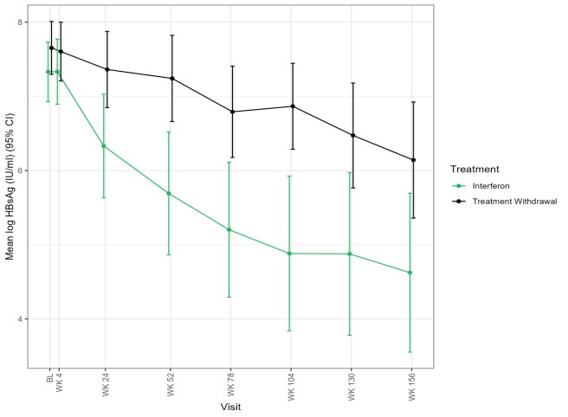
OS-069 A Randomised trial of nucleos(t)ide withdrawal vs nucleos(t)ide withdrawal with adjuvant pegylated-interferon in HBeAg-
negative hepatitis B virus infection to promote HBsAg clearance (NUC-B)
Results
qHBsAg decline over time
Exaggerated Hepatitis Flares
Outcome | NA Withdrawal Alone (N = 82) | NA Withdrawal + pIFN (N = 74)
HBsAg loss at 3 years | 3.0% | 14%
Return to NA therapy | 34.9% | 28.4%
Exaggerated flares | 27.9% | 13.4%
Serious AEs | No difference | No difference
 | Interferon (N = 67) | Treatment Withdrawal (N = 86)
No. of pts (% of pts) | 9 (13.4%) | 24 (27.9%)
No. of events | 12 | 36
Odds Ratio (95% CI) | 0.38 (0.16, 0.90)
p-value | 0.028
At 3 years, HBsAg loss was significantly higher in patients who received sequential NA withdrawal followed by pIFN compared to NA withdrawal alone.
Return to NA therapy was numerically lower in the NA withdrawal + pIFN group.
Exaggerated flares were observed less frequently with pIFN.
Greater and sustained decline with pIFN vs. withdrawal.
Conclusion
The use of adjuvant pIFN therapy after withdrawal of NA therapy increases the rate of functional cure of chronic HBV whilst
simultaneously reducing the number of exaggerated hepatitis flares thereby improving safety.
Notes:
Abbreviations: pIFN = Pegylated interferon; CHB = Chronic hepatitis B; HBsAG = hepatitis B surface antigen; NA = nucleos(t)ide analogue; pts =patients.
OS-069
A Randomised trial of nucleos(t)ide withdrawal vs nucleos(t)ide withdrawal with adjuvant pegylated-interferon in HBeAg-negative hepatitis B virus infection to promote HBsAg clearance (NUC-B)
Mark R Thursz1, Maud Lemoine2, Ashley Brown3, Ivana Carey4, Patrick Kennedy5, Martin Wiselka6, Mark Aldersley7, Martin Prince8, Stuart McPherson9, Eleni Nastouli10, Jack Message2, Mariam Habib2, Shilpa Chokshi11, Mala Maini10, Kosh Agarwal
1Imperial College, London, United Kingdom, 2Imperial College London, London, United Kingdom, 3Imperial College Healthcare NHS Trust, London, United Kingdom, 4Kings College Hospital, London, United Kingdom, 5Queen Mary University, London, United Kingdom, 6University Hospitals of Leicester, Leicester, United Kingdom, 7St James Hospital, Leeds, United Kingdom, 8Manchester Royal Infirmary, Manchester, United Kingdom, 9Newcastle University, Newcastle, United Kingdom, 10University College London, London, United Kingdom, 11Institute of Hepatology, London, United Kingdom
Email: m.thursz@imperial.ac.uk
Background and Aims:
Finite therapy resulting in a functional cure (sustained hepatitis B surface antigen (HBsAg) loss) for patients with chronic HBV infection (CHB) is an important therapeutic goal. In patients with HBeAg-negative infection, nucleos(t)ide analogue (NA) withdrawal may achieve HBsAg loss in 5-20% of patients 3 years after cessation of NA therapy depending on duration of NA therapy, HBsAg level, HBV genotype and patient age. Pegylated interferon (pIFN) is a recognized treatment for CHB but is currently under-utilised and simultaneous treatment with pIFN and NA does not enhance rates of HBsAg loss.
We hypothesized that sequential NA withdrawal followed by a short course of pIFN might enhance HBsAg clearance.
Method:
NUC-B was a randomized, open-label multi-centre UK trial in NA-treated non-cirrhotic HBeAg negative patients with CHB. Patients were allocated to either NA withdrawal alone or NA withdrawal followed by a 16 week course of pIFN 180ug weekly commencing 4 weeks after NA cessation. Randomisation was stratified according to HBsAg quantification. The primary endpoint was HBsAg loss at 3 years. Exaggerated flares were defined according to the following criteria:
1. Bilirubin > 35 uMol/l
2. INR >1.3
3. ALT > 20 x upper limit of normal
4. HBV DNA and/or ALT remain persistently elevated for more than 6 months
Results:
156 patients (82 to NA withdrawal, 74 to NA withdrawal + pIFN) were recruited between 2017 and 2021; median age 45 years, 24% of patients were female, 13.5% were Caucasian, 42% were African and 37% Asian, HBV Genotypes were A 14%, B 4%, C 4%, D 20%, E 15%, other 1%, unknown 42%. HBsAg titre at baseline was 5717 IU/ml in the NA withdrawal group and 4132 IU/ml in the NA withdrawal + pIFN group. HBsAg was < 2000 in 52% of patients in the NA withdrawal group and 51% in the NA withdrawal + pIFN group
In this globally representative group, at 3 years 3% of patients in the NA withdrawal arm and 14% of patients in the NA withdrawal + pIFN arm lost HBsAg (odds ratio 5.39, P = 0.037). In the NA withdrawal arm 34.9% of patients returned to NA therapy compared to 28.4% in the NA withdrawal + Peg-IFN arm. Exaggerated flares occurred in 27.9% of patients in the NA withdrawal arm compared with 13.4% in the NA withdrawal + pIFN arm. Serious adverse events did not differ between the groups.
Conclusion:
The use of adjuvant pIFN therapy after withdrawal of NA therapy increases the rate of functional cure of chronic HBV whilst simultaneously reducing the number of exaggerated hepatitis flares thereby improving safety.

Slide 23
OS-070 Achieving undetectable hepatitis delta virus RNA at end of therapy with bulevirtide 10 mg/day with or without with pegylated interferon alpha is strongly associated with post-treatment virologic response in chronic hepatitis delta
Background and Aims
Methods
Bulevirtide (BLV) 2 mg is approved in the European Economic Area, Great Britain, Switzerland, the Russian Federation, and Australia, for the treatment of compensated chronic hepatitis delta (CHD).
The clinical relevance of achieving undetectable HDV RNA (TND) vs detectable but low level viraemia (<LLOQ; TD) at the end of treatment (EOT) remains unclear.
Aim: To evaluate the association between EOT HDV RNA status (TND vs TD <LLOQ) and virologic response at posttreatment follow-up week (W) 48 (FU48).
Pooled data from the Phase 2 MYR204 and the Phase 3 MYR301
BLV 10 mg + PegIFNα (48W) BLV 10 mg alone (48W)
(n = 50)
BLV 10 mg for 96W
(n = 100)
BLV 10 mg for 144W (n = 50)
FU48 after EOT
Analysis
RT-qPCR
Virologic response
HDV RNA determined using RoboGene 2.0 LLOQ 50 IU/mL
limit of detection 6 IU/mL.
Response rate at FU48
undetectable HDV RNA vs HDV RNA <LLOQ, TD at EOT.
Notes:
Abbreviations: pIFN = Pegylated interferon; CHB = Chronic hepatitis B; HBsAG = hepatitis B surface antigen; NA = nucleos(t)ide analogue; pts =patients.
OS-070
Achieving undetectable hepatitis delta virus RNA at end of therapy with bulevirtide 10 mg/day with or without with pegylated interferon alpha is strongly associated with post-treatment virologic response in chronic hepatitis delta
Fabien Zoulim1, Tarik Asselah2, Soo Aleman3, Maurizia Brunetto4 5, Vladimir Chulanov6, Adrian Streinu-Cercel7 8, George Sebastian Gherlan9 10, Pavel Bogomolov11, Tatiana Stepanova12, Viacheslav Morozov13, Olga Sagalova14, Renee-Claude Mercier15, Lei Ye15
1Lyon Hepatology Institute, Lyon, France, 2Hôpital Beaujon APHP, Université de Paris-Cité, INSERM UMR1149, Clichy, France, 3Karolinska University Hospital/Karolinska Institutet, Department of Infectious Diseases, Stockholm, Sweden, 4Hepatology Unit, Reference Center of the Tuscany Region for Chronic Liver Disease and Cancer, University Hospital of Pisa, Pisa, Italy, 5Department of Clinical and Experimental Medicine, University of Pisa, Pisa, Italy, 6Sechenov University, Moscow, Russian Federation, 7Matei Bals National Institute of Infectious Diseases, Bucharest, Romania, 8“Carol Davila” University of Medicine and Pharmacy, Bucharest, Romania, 9"Carol Davila” University of Medicine and Pharmacy, Bucharest, Romania, 10Dr. Victor Babes Foundation, Bucharest, Romania, 11M.F. Vladimirsky Moscow Regional Research and Clinical Institute, Moscow, Russian Federation, 12LLC Clinic of Modern Medicine, Moscow, Russian Federation, 13LLC Medical Company “Hepatolog", Samara, Russian Federation, 14South Ural State Medical University, Chelyabinsk, Russian Federation, 15Gilead Sciences, Inc., Foster City, United States
Email: renee-claude.mercier@gilead.com
Background and Aims: Bulevirtide (BLV) 2 mg is approved for the treatment of chronic hepatitis delta (CHD) in Europe. In an integrated analysis of BLV 10 mg monotherapy or combined with pegylated interferon alpha (PegIFN), we aim to explore whether hepatitis delta virus (HDV) RNA levels undetectable (target not detected; TND) vs below the lower limit of quantification (< LLOQ; target detected [TD]) at end of treatment (EOT) affect post-treatment virologic response.
Method: A pooled analysis of data from patients who completed 2 or 3 years of BLV 10 mg/d with or without PegIFN in the Phase 2 study MYR204 (NCT03852433) and the Phase 3 study MYR301 (NCT03852719) was performed. Patients received (A) BLV 10 mg + PegIFN for 48 weeks (W) followed by 48W of monotherapy with BLV 10 mg (n = 50), (B) BLV 10 mg for 96W (n = 100), or (C) BLV 10 mg for 144W (n = 50). Patients were followed for up to 48W after EOT (FU-48). HDV RNA levels were determined by reverse transcription–quantitative polymerase chain reaction using RoboGene 2.0 (LLOQ 50 IU/mL, limit of detection 6 IU/mL). Virologic response rates at FU-48 were
compared between patients with undetectable HDV RNA and those with HDV RNA < LLOQ, TD at EOT.
Results: Demographics were generally similar across groups: male (65%), White (85%), and mean (SD) age 41 (8.2) years. Overall, 41% had compensated cirrhosis, and 53% had prior interferon experience. Mean (SD) HDV RNA, alanine aminotransferase, and liver stiffness were 5.1 (1.38)log10 IU/mL, 109 (88.2)U/L, and 14.0 (9.11)kPa, respectively. At EOT, 48.5% (97/200) overall achieved undetectable HDV RNA: (A) 70% (35/50), (B) 37% (37/100), and (C) 50% (25/50). Additionally, 24% (48/200) had < LLOQ, TD: (A) 16% (8/50), (B) 30% (30/100), and (C) 20% (10/50). At FU-48 in the whole population, undetectable HDV RNA was observed in 24.5% (49/200): 23/50 (46%) of those receiving combination therapy, 14% (14/100) of patients who received BLV monotherapy for 2 years, and 24% (12/50) of those who received 3 years of BLV monotherapy. Of the patients with undetectable HDV RNA at EOT, 46% (45/97) maintained undetectable HDV RNA at FU-48: (A) 60% (21/35), (B) 35% (13/37), and (C) 44% (11/25); 6% (6/97) had < LLOQ, TD at FU-48: (A) 6% (2/35), (B) 9% (3/37), and (C) 4% (1/25). Of those who had < LLOQ, TD at EOT, only 6% (3/48) had undetectable HDV RNA (1 in each group) and 4% (2/48) remained < LLOQ, TD at FU-48, while 71% (34/48) had HDV RNA > LLOQ: (A) 62.5% (5/8), (B) 80% (24/30), and (C) 50% (5/10); during the follow-up period, 9 discontinued the study early.
Conclusion: In patients with compensated CHD, achieving undetectable HDV RNA with TND at EOT is strongly associated with a virologic suppression at 48W post-treatment. Combination therapy with BLV 10 mg/d and PegIFN and longer treatment with BLV monotherapy were associated with higher rates of undetectable HDV RNA at EOT and FU-48. Patients with HDV RNA < LLOQ, TD at EOT are likely to have HDV RNA rebound off therapy.

Slide 24
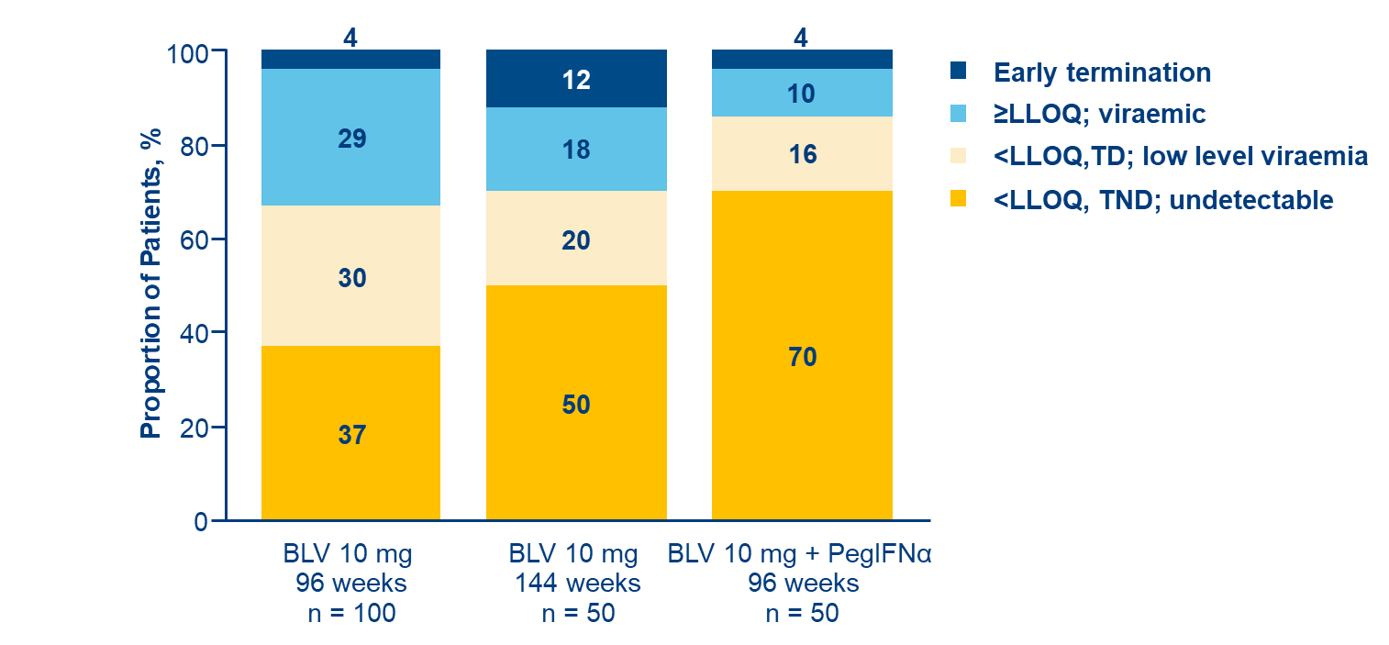
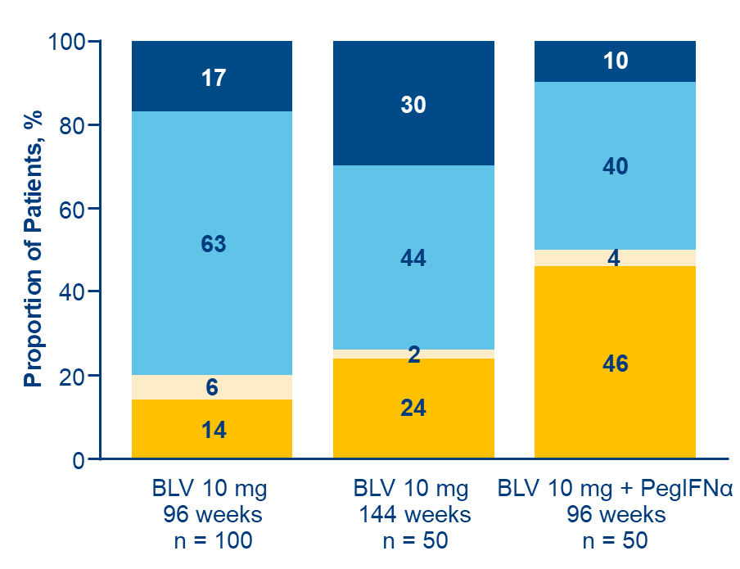
OS-070 Achieving undetectable hepatitis delta virus RNA at end of therapy with bulevirtide 10 mg/day with or without with pegylated interferon alpha is strongly associated with post-treatment virologic response in chronic hepatitis delta
Results
Virologic response
Baseline characteristics
Characteristic | Total (N = 200)
Male (%) | 65%
White (%) | 85%
Age, years, mean (SD) | 41 (±8.2)
Compensated cirrhosis (%) | 41%
Prior interferon use (%) | 53%
HDV RNA, log₁₀ IU/mL, mean (SD) | 5.1 (±1.38)
ALT, U/L, mean (SD) | 109 (±88.2)
Liver stiffness, kPa, mean (SD) | 14.0 (±9.11)
At EOT
At FU48
Conclusion
Among patients with compensated CHD, those with undetectable HDV RNA at FU48 were more likely to be those with undetectable HDV RNA, TND at EOT.
Combination therapy with BLV 10 mg/d and PegIFNα and longer treatment with BLV monotherapy were associated with higher rates of undetectable HDV RNA at EOT and FU48.
Patients with HDV RNA <LLOQ, TD at EOT were likely to have HDV RNA rebound off therapy.
Notes:
Abbreviations: BLV = Bulevirtide; CHD = Chronic hepatitis delta; EOT = End of treatment; TND = Target not detected; TD = Target detected; FU =Follow-up.
OS-070
Achieving undetectable hepatitis delta virus RNA at end of therapy with bulevirtide 10 mg/day with or without with pegylated interferon alpha is strongly associated with post-treatment virologic response in chronic hepatitis delta
Fabien Zoulim1, Tarik Asselah2, Soo Aleman3, Maurizia Brunetto4 5, Vladimir Chulanov6, Adrian Streinu-Cercel7 8, George Sebastian Gherlan9 10, Pavel Bogomolov11, Tatiana Stepanova12, Viacheslav Morozov13, Olga Sagalova14, Renee-Claude Mercier15, Lei Ye15
1Lyon Hepatology Institute, Lyon, France, 2Hôpital Beaujon APHP, Université de Paris-Cité, INSERM UMR1149, Clichy, France, 3Karolinska University Hospital/Karolinska Institutet, Department of Infectious Diseases, Stockholm, Sweden, 4Hepatology Unit, Reference Center of the Tuscany Region for Chronic Liver Disease and Cancer, University Hospital of Pisa, Pisa, Italy, 5Department of Clinical and Experimental Medicine, University of Pisa, Pisa, Italy, 6Sechenov University, Moscow, Russian Federation, 7Matei Bals National Institute of Infectious Diseases, Bucharest, Romania, 8“Carol Davila” University of Medicine and Pharmacy, Bucharest, Romania, 9"Carol Davila” University of Medicine and Pharmacy, Bucharest, Romania, 10Dr. Victor Babes Foundation, Bucharest, Romania, 11M.F. Vladimirsky Moscow Regional Research and Clinical Institute, Moscow, Russian Federation, 12LLC Clinic of Modern Medicine, Moscow, Russian Federation, 13LLC Medical Company “Hepatolog", Samara, Russian Federation, 14South Ural State Medical University, Chelyabinsk, Russian Federation, 15Gilead Sciences, Inc., Foster City, United States
Email: renee-claude.mercier@gilead.com
Background and Aims: Bulevirtide (BLV) 2 mg is approved for the treatment of chronic hepatitis delta (CHD) in Europe. In an integrated analysis of BLV 10 mg monotherapy or combined with pegylated interferon alpha (PegIFN), we aim to explore whether hepatitis delta virus (HDV) RNA levels undetectable (target not detected; TND) vs below the lower limit of quantification (< LLOQ; target detected [TD]) at end of treatment (EOT) affect post-treatment virologic response.
Method: A pooled analysis of data from patients who completed 2 or 3 years of BLV 10 mg/d with or without PegIFN in the Phase 2 study MYR204 (NCT03852433) and the Phase 3 study MYR301 (NCT03852719) was performed. Patients received (A) BLV 10 mg + PegIFN for 48 weeks (W) followed by 48W of monotherapy with BLV 10 mg (n = 50), (B) BLV 10 mg for 96W (n = 100), or (C) BLV 10 mg for 144W (n = 50). Patients were followed for up to 48W after EOT (FU-48). HDV RNA levels were determined by reverse transcription–quantitative polymerase chain reaction using RoboGene 2.0 (LLOQ 50 IU/mL, limit of detection 6 IU/mL). Virologic response rates at FU-48 were
compared between patients with undetectable HDV RNA and those with HDV RNA < LLOQ, TD at EOT.
Results: Demographics were generally similar across groups: male (65%), White (85%), and mean (SD) age 41 (8.2) years. Overall, 41% had compensated cirrhosis, and 53% had prior interferon experience. Mean (SD) HDV RNA, alanine aminotransferase, and liver stiffness were 5.1 (1.38)log10 IU/mL, 109 (88.2)U/L, and 14.0 (9.11)kPa, respectively. At EOT, 48.5% (97/200) overall achieved undetectable HDV RNA: (A) 70% (35/50), (B) 37% (37/100), and (C) 50% (25/50). Additionally, 24% (48/200) had < LLOQ, TD: (A) 16% (8/50), (B) 30% (30/100), and (C) 20% (10/50). At FU-48 in the whole population, undetectable HDV RNA was observed in 24.5% (49/200): 23/50 (46%) of those receiving combination therapy, 14% (14/100) of patients who received BLV monotherapy for 2 years, and 24% (12/50) of those who received 3 years of BLV monotherapy. Of the patients with undetectable HDV RNA at EOT, 46% (45/97) maintained undetectable HDV RNA at FU-48: (A) 60% (21/35), (B) 35% (13/37), and (C) 44% (11/25); 6% (6/97) had < LLOQ, TD at FU-48: (A) 6% (2/35), (B) 9% (3/37), and (C) 4% (1/25). Of those who had < LLOQ, TD at EOT, only 6% (3/48) had undetectable HDV RNA (1 in each group) and 4% (2/48) remained < LLOQ, TD at FU-48, while 71% (34/48) had HDV RNA > LLOQ: (A) 62.5% (5/8), (B) 80% (24/30), and (C) 50% (5/10); during the follow-up period, 9 discontinued the study early.
Conclusion: In patients with compensated CHD, achieving undetectable HDV RNA with TND at EOT is strongly associated with a virologic suppression at 48W post-treatment. Combination therapy with BLV 10 mg/d and PegIFN and longer treatment with BLV monotherapy were associated with higher rates of undetectable HDV RNA at EOT and FU-48. Patients with HDV RNA < LLOQ, TD at EOT are likely to have HDV RNA rebound off therapy.

Slide 25
OS-073 Entry inhibitor Hepalatide combined with pegylated interferon-alpha 2a therapy resulted in cccDNA clearance in CHB patients: a phase II randomised, double-blind, placebo-controlled trial
Background and Aims
HLT is a peptide designed to block the HBV entry receptor NTCP.
Aim
To evaluate the efficacy and safety of HLT in combination with pegylated interferon-alpha 2a (PEG-IFN) in patients with chronic hepatitis B (CHB).
Methods
Phase II multicentre, randomised, double-blind, placebo-controlled trial (NCT 04426968)
Number of Patients | 96
Age | 18-60 Years
HBV DNA | HBeAg-positive (≥ 20,000 IU/mL ) or HBeAg-negative (≥ 2,000 IU/mL)
Cirrhosis | None
IFN | Naïve
Placebo
(n = 24)
2.1 mg HLT (n = 24)
Primary endpoint (24-weeks):
Safety
HBV DNA loss (cut-off: 20 IU/mL)
HBsAg, Pg RNA, cccDNA and histological response in liver biopsy were also assessed at the end of the 24-week treatment.
24-week
treatment*
4.2 mg HLT (n = 24)
6.3 mg HLT (n =2 4)
*All subjects received PEG-IFN (180 μg/week) concomitantly for 48 weeks.
Notes:
Abbreviations: HLT = Hepalatide; NTCP = sodium-bile acid cotransporter; Aes = Adverse Events.
OS-073
Entry inhibitor Hepalatide combined with pegylated interferon-alpha 2a therapy resulted in cccDNA clearance in CHB patients: a phase II randomised, double-blind, placebo-controlled trial
Junliang Fu, Qing Mao1, Qinglong Jin2, Hui Chen3, Yongqian Cheng4, Xiaolu Tang5, Hongli Liu5, Fu-Sheng Wang
1Department of Infectious Diseases, Southwest Hospital, Army Medical University, Chongqing, China, 2Department of Hepatology, The First Hospital of Jilin University, Jilin University, Changchun, China, 3Department of hepatitis, Hepatobiliary hospital of Jilin, Changchun, China, 4Senior Department of Infectious Diseases, The Fifth Medical Center of Chinese PLA General Hospital, National Clinical Research Center for Infectious Diseases, Beijing, China, 5Shanghai HEP Pharma Co. Ltd., Shanghai, China
Email: fswang302@163.com
Background and Aims: Hepalatide (HLT) is a peptide designed to block the HBV entry receptor sodium-bile acid cotransporter (NTCP). This study aimed to evaluate the efficacy and safety of HLT in combination with pegylated interferon-alpha 2a (PEG-IFN) in patients with chronic hepatitis B (CHB).
Method: This Phase II multicentre, randomised, double-blind, placebo-controlled trial enrolled 96 patients aged 18–60 years with HBV DNA ≥ 20,000 IU/mL (HBeAg-positive) or ≥ 2,000 IU/mL (HBeAg-negative), no cirrhosis, and naïve to interferon treatment (NCT 04426968). Participants were randomly assigned to receive 2.1mg, 4.2mg, 6.3 mg of HLT treatment, or placebo for 24 weeks in a 1:1:1:1 ratio. All subjects received PEG-IFN (180μg/week) foundational treatment for 48 weeks. The primary endpoint was safety and HBV DNA loss (cut-off: 20 IU/mL) at 24 weeks of treatment. HBsAg, Pg RNA, cccDNA and histological response in liver biopsy were also assessed at the end of the 24-week treatment.
Results: A total of 96 subjects (77 HBeAg-positive and 19 HBeAg-negative) were included in the trial, with 24 patients in each group. Two patients withdrew due to interferon-related AEs. A total of 1281 AEs ranging from grade 1 to 3 were recorded, and mainly interferon-related. Only 26 AEs were related to HLT, and all AEs were graded 1 or 2. The proportion of patients with virological response (HBV DNA < 20 IU/mL or a decrease from baseline ≥ 2 log10) at the end of the 24-week HLT treatment in the 2.1 mg, 4.2 mg, or 6.3 mg and placebo group were 78.3%, 87.5%, 70.8% and 58.3%, respectively. The virological response rate in the 4.2mg group was significantly higher than that in placebo group (p = 0.0248). At baseline and the end of 24-week HLT treatment, 21 and 14 liver biopsies were obtained, respectively. All four groups had positive baseline biopsies cccDNA of 3.463 ± 1.03, 2.383 ± 0.97, 3.850 ± 1.08, and 3.018 ± 0.76 log10 copies/μL, respectively. Surprisingly, cccDNA became undetectable (< 5 copies/μL by verified PCR assay) in 33.3% (1/3) and 40.0% (2/5) of samples from the 4.2mg and 6.3mg groups at the end of the 24-week HLT treatment, while all samples from 2.1mg and placebo groups remained cccDNA positive. The three subjects with cccDNA clearance remained HBsAg-positive at the end of HLT treatment. Pg RNA levels and HBsAg levels were progressively reduced in all groups during the treatment. The fact that all indicates that this HBsAg may be expressed from integrated HBV DNA.
Conclusion: The combination therapy in the present trial may alter the balance of the HBV reservoir by blocking cccDNA replenishment through inhibiting HBV entry via HLT and accelerating cccDNA
decay via PEG-IFN. This strategy provides great potential to achieve a sterilising cure for patients with CHB.

Slide 26
OS-073 Entry inhibitor Hepalatide combined with pegylated interferon-alpha 2a therapy resulted in cccDNA clearance in CHB patients: a phase II randomised, double-blind, placebo-controlled trial
Results
Conclusion
Adverse Events
Virological Response
The combination therapy in the present trial may alter the balance of the HBV reservoir by blocking cccDNA replenishment through inhibiting HBV entry via HLT and accelerating cccDNA decay via PEG-IFN.
This strategy provides great potential to achieve a sterilising cure for patients with CHB.
Two patients withdrew due to interferon-related AEs.
1281 AEs → mostly PEG-IFN-related. Only 26 HLT-related (Grade 1-2).
 | 2.1 mg HLT | 4.2 mg HLT | 6.3 mg HLT | Placebo
Virological response* | 78.30% | 87.50% | 70.80% | 58.30%
(HBV DNA < 20 IU/mL or decrease from baseline ≥ 2 log10)
*Virological response rate in the 4.2mg group was significantly higher than that in placebo group (p = 0.0248)
cccDNA
 | 2.1 mg HLT | 4.2 mg HLT | 6.3 mg HLT | Placebo
Baseline ccccDNA (log10 copies/μL) | 3.463 ± 1.03 | 2.383 ± 0.97 | 3.850 ± 1.08 | 3.018 ± 0.76
24-week ccDNA | All samples cccDNA positive | Undetectable* in 33.3% of samples | Undetectable* in 40.0% of samples | All samples cccDNA positive
The three subjects with cccDNA clearance remained HBsAg-positive at the end of HLT treatment.
*< 5 copies/μL by verified PCR assay
Notes:
Abbreviations: HLT = Hepalatide; NTCP = sodium-bile acid cotransporter; Aes = Adverse Events.
OS-073
Entry inhibitor Hepalatide combined with pegylated interferon-alpha 2a therapy resulted in cccDNA clearance in CHB patients: a phase II randomised, double-blind, placebo-controlled trial
Junliang Fu, Qing Mao1, Qinglong Jin2, Hui Chen3, Yongqian Cheng4, Xiaolu Tang5, Hongli Liu5, Fu-Sheng Wang
1Department of Infectious Diseases, Southwest Hospital, Army Medical University, Chongqing, China, 2Department of Hepatology, The First Hospital of Jilin University, Jilin University, Changchun, China, 3Department of hepatitis, Hepatobiliary hospital of Jilin, Changchun, China, 4Senior Department of Infectious Diseases, The Fifth Medical Center of Chinese PLA General Hospital, National Clinical Research Center for Infectious Diseases, Beijing, China, 5Shanghai HEP Pharma Co. Ltd., Shanghai, China
Email: fswang302@163.com
Background and Aims: Hepalatide (HLT) is a peptide designed to block the HBV entry receptor sodium-bile acid cotransporter (NTCP). This study aimed to evaluate the efficacy and safety of HLT in combination with pegylated interferon-alpha 2a (PEG-IFN) in patients with chronic hepatitis B (CHB).
Method: This Phase II multicentre, randomised, double-blind, placebo-controlled trial enrolled 96 patients aged 18–60 years with HBV DNA ≥ 20,000 IU/mL (HBeAg-positive) or ≥ 2,000 IU/mL (HBeAg-negative), no cirrhosis, and naïve to interferon treatment (NCT 04426968). Participants were randomly assigned to receive 2.1mg, 4.2mg, 6.3 mg of HLT treatment, or placebo for 24 weeks in a 1:1:1:1 ratio. All subjects received PEG-IFN (180μg/week) foundational treatment for 48 weeks. The primary endpoint was safety and HBV DNA loss (cut-off: 20 IU/mL) at 24 weeks of treatment. HBsAg, Pg RNA, cccDNA and histological response in liver biopsy were also assessed at the end of the 24-week treatment.
Results: A total of 96 subjects (77 HBeAg-positive and 19 HBeAg-negative) were included in the trial, with 24 patients in each group. Two patients withdrew due to interferon-related AEs. A total of 1281 AEs ranging from grade 1 to 3 were recorded, and mainly interferon-related. Only 26 AEs were related to HLT, and all AEs were graded 1 or 2. The proportion of patients with virological response (HBV DNA < 20 IU/mL or a decrease from baseline ≥ 2 log10) at the end of the 24-week HLT treatment in the 2.1 mg, 4.2 mg, or 6.3 mg and placebo group were 78.3%, 87.5%, 70.8% and 58.3%, respectively. The virological response rate in the 4.2mg group was significantly higher than that in placebo group (p = 0.0248). At baseline and the end of 24-week HLT treatment, 21 and 14 liver biopsies were obtained, respectively. All four groups had positive baseline biopsies cccDNA of 3.463 ± 1.03, 2.383 ± 0.97, 3.850 ± 1.08, and 3.018 ± 0.76 log10 copies/μL, respectively. Surprisingly, cccDNA became undetectable (< 5 copies/μL by verified PCR assay) in 33.3% (1/3) and 40.0% (2/5) of samples from the 4.2mg and 6.3mg groups at the end of the 24-week HLT treatment, while all samples from 2.1mg and placebo groups remained cccDNA positive. The three subjects with cccDNA clearance remained HBsAg-positive at the end of HLT treatment. Pg RNA levels and HBsAg levels were progressively reduced in all groups during the treatment. The fact that all indicates that this HBsAg may be expressed from integrated HBV DNA.
Conclusion: The combination therapy in the present trial may alter the balance of the HBV reservoir by blocking cccDNA replenishment through inhibiting HBV entry via HLT and accelerating cccDNA
decay via PEG-IFN. This strategy provides great potential to achieve a sterilising cure for patients with CHB.

Slide 27
Viral Hepatitis B and D
Current Therapies

Slide 28
OS-065 The multi-center study of functional cure for inactive hepatitis B surface antigen carriers in China: interim analysis of E-cure study
Background and Aims
Approximately 30-60% of IHCs exhibit significant liver inflammation (G ≥ 2) or fibrosis (F ≥ 2) on liver biopsy.
E-cure, a multi-centre real world study started, in January 2022.
Aim: To investigate the efficacy of different PegIFNα-based treatment strategies and factors influencing HBsAg clearance for IHCs part of the E-cure study.
Methods
1038 IHC patients included in 4 treatment arms for 48 weeks
PegIFNα monotherapy (n = 691)
Initial combination
PegIFNα-2b + NAs for 12-24w then PegIFNα-2b monotherapy
(n = 26)
Whole process combination PegIFNα-2b and NAs for treatment duration
(n = 221)
Sequential combination
NAs for 12-24w then +PegIFNα-2b
(n = 41)
Notes:
OS-065
The multi-center study of functional cure for inactive hepatitis B surface antigen carriers in China: interim analysis of E-cure study
zhishuo mo1, Haifang Cao2, Yu Zhang2, Yawen Luo3, Qingfa Ruan4, Jianqi Lian5, Xiulan Xue6, Xiaobo Lu7, Xiangyang Ye8, Rongxian Qiu8, Xiaoping Wu9, xiaorong mao10, Qihuan Xu11, Zhiliang Gao11
1The Third Affiliated Hospital of Sun Yat-sen University, Guangzhou, China, 2Qinghai Provincial Fourth People's Hospital, Xi ning, China, 3Affiliated Hospital of Zunyi Medical University, Zunyi, China, 4Xiamen Hospital of Traditional Chinese Medicine, Xiamen, China, 5The Second Affiliated Hospital of Air Force Medical University, xi‘an, China, 6The First Affiliated Hospital of Xiamen University, Xiamen, China, 7The First Affiliated Hospital of Xinjiang Medical University, Urumchi, China, 8Affiliated Hospital of Putian University, Putian, China, 9The First Affiliated Hospital Of Nanchang University, Nanchang, China, 10The First Hospital of Lanzhou University, Lanzhou, China, 11The third affiliated hospital of Sun Yat-sen university, Guangzhou, China
Email: mozhsh@mail.sysu.edu.cn
Background and Aims:
Approximately 30% to 60% of inactive hepatitis B surface antigen carriers (IHCs) exhibit significant liver inflammation (G ≥ 2) or fibrosis (F ≥ 2) on liver biopsy, underscoring the need for therapeutic intervention. This study aimed to investigate the efficacy of different peginterferon alpha (PegIFNα)-based treatment strategies and factors influencing HBsAg clearance for IHCs.
Method:
A multi-center real world study (E-cure) started in January 2022. The study enrolled IHCs consistent with the definition of inactive CHB in the guideline of AASLD 2018. The patients received one of the following treatments: Nucleos(t)ide analogues (NAs) monotherapy, PegIFNα monotherapy, Initial combination therapy (PegIFNα-2b with NAs for 12-24w followed by PegIFNα-2b monotherapy), Whole process combination therapy (combination of PegIFNα-2b and NAs for the entire period) and Sequential combination therapy (NAs for 12-24w followed by PegIFNα-2b add-on).
Results:
As of November 4, 2024, 7899 individuals were screened and 5328 eligible IHCs were included. Of these, 1038 completed 48 weeks of treatment, with 691 in the PegIFNα monotherapy group, 94 in the Initial combination therapy group, 212 in the Whole process combination therapy group, and 41 in the s Sequential combination therapy group. The median (IQR) age of all patients was 41.0 (34.0-48.0) years, 62.1% were male, 38.2% had a baseline HBsAg < 100 IU/mL, 35.0% had levels between 100 and 1000 IU/mL, 26.8% had levels ≥ 1000 IU/mL, and 90.8% had a baseline HBV DNA < 1000 IU/mL. The HBsAg clearance and seroconversion rates in patients treated with PegIFNα-2b increased as the duration of treatment progressed. By week 48, the cumulative HBsAg clearance rates for the PegIFNα monotherapy, Initial combination therapy, Whole process combination therapy and Sequential combination therapy groups reached 53.3%, 34%, 58% and 65.8%, respectively (P < 0.001), and the cumulative HBsAg seroconversion rates reached 36.8%, 17.6%, 30.1% and 53.3%, respectively (P < 0.001). The cumulative HBsAg clearance rates at 48 weeks for the baseline HBsAg <100 IU/ml, 100-1000 IU/ml, and >1000 IU/ml groups were 72.56%, 42.62%, and 8.89%, respectively. HBV DNA was undetectable in more than 90% of patients in the above 4 groups (92.8%, 95.7%, 97.9% and 95%). Multivariate logistic regression analysis indicated that a lower baseline HBsAg level (OR = 0.220, 95%CI 0.169-0.280, p < 0.001), a higher HBsAg reduction at 24 weeks (OR = 5.168, 95%CI 3.909-7.031, p < 0.001), and the Whole process combination therapy group (OR = 3.064, 95%CI 1.589-6.106, p = 0.001) had a higher likelihood of achieving HBsAg clearance at 48 weeks.
Conclusion:
PegIFNα-2b based therapy proved effective for IHCs to pursue functional cure. The efficacy for HBsAg clearance is associated with baseline HBsAg level, HBsAg reduction at 24 weeks, and the treatment regimen.

Slide 29
OS-065 The multi-center study of functional cure for inactive hepatitis B surface antigen carriers in China: interim analysis of E-cure study
Results
Baseline characteristics were comparable across groups: median age 41 years, 62.1% male, with 38.2% of patients having baseline HBsAg < 100 IU/mL.
Predictors of HBsAg clearance
HBsAg clearance and seroconversion at 48 Weeks
Baseline HBsAg level | HBsAg clearance Rate
< 100 IU/mL | 72.60%
100-1000 IU/mL | 43%
> 1000 IU/mL | 9%
Treatment | Clearance | Seroconversion
PegIFNα mono | 53.30% | 36.80%
Initial combo | 34% | 17.60%
Whole process combo | 58% | 30.10%
Sequential combo | 65.80% | 53.30%
Cumulative HBsAg clearance rates increased with intensified PegIFNα-based strategies.
Lower baseline HBsAg (OR=0.220, 95% CI 0.169–0.280)
HBsAg drop at 24w (OR=5.168, CI 3.909–7.031)
Whole process combo (OR=3.064, CI 1.589–6.106)
HBV DNA undetectable in >90% of all groups
P < 0.001 across groups.
Conclusion
PegIFNα-2b based therapy proved effective for IHCs to pursue functional cure. The efficacy for HBsAg clearance is associated with baseline HBsAg level, HBsAg reduction at 24 weeks, and the treatment regimen.
Notes:
OS-065
The multi-center study of functional cure for inactive hepatitis B surface antigen carriers in China: interim analysis of E-cure study
zhishuo mo1, Haifang Cao2, Yu Zhang2, Yawen Luo3, Qingfa Ruan4, Jianqi Lian5, Xiulan Xue6, Xiaobo Lu7, Xiangyang Ye8, Rongxian Qiu8, Xiaoping Wu9, xiaorong mao10, Qihuan Xu11, Zhiliang Gao11
1The Third Affiliated Hospital of Sun Yat-sen University, Guangzhou, China, 2Qinghai Provincial Fourth People's Hospital, Xi ning, China, 3Affiliated Hospital of Zunyi Medical University, Zunyi, China, 4Xiamen Hospital of Traditional Chinese Medicine, Xiamen, China, 5The Second Affiliated Hospital of Air Force Medical University, xi‘an, China, 6The First Affiliated Hospital of Xiamen University, Xiamen, China, 7The First Affiliated Hospital of Xinjiang Medical University, Urumchi, China, 8Affiliated Hospital of Putian University, Putian, China, 9The First Affiliated Hospital Of Nanchang University, Nanchang, China, 10The First Hospital of Lanzhou University, Lanzhou, China, 11The third affiliated hospital of Sun Yat-sen university, Guangzhou, China
Email: mozhsh@mail.sysu.edu.cn
Background and Aims:
Approximately 30% to 60% of inactive hepatitis B surface antigen carriers (IHCs) exhibit significant liver inflammation (G ≥ 2) or fibrosis (F ≥ 2) on liver biopsy, underscoring the need for therapeutic intervention. This study aimed to investigate the efficacy of different peginterferon alpha (PegIFNα)-based treatment strategies and factors influencing HBsAg clearance for IHCs.
Method:
A multi-center real world study (E-cure) started in January 2022. The study enrolled IHCs consistent with the definition of inactive CHB in the guideline of AASLD 2018. The patients received one of the following treatments: Nucleos(t)ide analogues (NAs) monotherapy, PegIFNα monotherapy, Initial combination therapy (PegIFNα-2b with NAs for 12-24w followed by PegIFNα-2b monotherapy), Whole process combination therapy (combination of PegIFNα-2b and NAs for the entire period) and Sequential combination therapy (NAs for 12-24w followed by PegIFNα-2b add-on).
Results:
As of November 4, 2024, 7899 individuals were screened and 5328 eligible IHCs were included. Of these, 1038 completed 48 weeks of treatment, with 691 in the PegIFNα monotherapy group, 94 in the Initial combination therapy group, 212 in the Whole process combination therapy group, and 41 in the s Sequential combination therapy group. The median (IQR) age of all patients was 41.0 (34.0-48.0) years, 62.1% were male, 38.2% had a baseline HBsAg < 100 IU/mL, 35.0% had levels between 100 and 1000 IU/mL, 26.8% had levels ≥ 1000 IU/mL, and 90.8% had a baseline HBV DNA < 1000 IU/mL. The HBsAg clearance and seroconversion rates in patients treated with PegIFNα-2b increased as the duration of treatment progressed. By week 48, the cumulative HBsAg clearance rates for the PegIFNα monotherapy, Initial combination therapy, Whole process combination therapy and Sequential combination therapy groups reached 53.3%, 34%, 58% and 65.8%, respectively (P < 0.001), and the cumulative HBsAg seroconversion rates reached 36.8%, 17.6%, 30.1% and 53.3%, respectively (P < 0.001). The cumulative HBsAg clearance rates at 48 weeks for the baseline HBsAg <100 IU/ml, 100-1000 IU/ml, and >1000 IU/ml groups were 72.56%, 42.62%, and 8.89%, respectively. HBV DNA was undetectable in more than 90% of patients in the above 4 groups (92.8%, 95.7%, 97.9% and 95%). Multivariate logistic regression analysis indicated that a lower baseline HBsAg level (OR = 0.220, 95%CI 0.169-0.280, p < 0.001), a higher HBsAg reduction at 24 weeks (OR = 5.168, 95%CI 3.909-7.031, p < 0.001), and the Whole process combination therapy group (OR = 3.064, 95%CI 1.589-6.106, p = 0.001) had a higher likelihood of achieving HBsAg clearance at 48 weeks.
Conclusion:
PegIFNα-2b based therapy proved effective for IHCs to pursue functional cure. The efficacy for HBsAg clearance is associated with baseline HBsAg level, HBsAg reduction at 24 weeks, and the treatment regimen.

Slide 30
OS-066 Predictors of undetectable hepatitis delta virus RNA at 48 weeks after end of treatment with bulevirtide monotherapy in the MYR 301 study
Background and Aims
Bulevirtide (BLV) is approved in the European Economic Area, Great Britain, Switzerland, the Russian Federation, and Australia for the treatment of compensated chronic hepatitis delta (CHD).
In MYR301 (Phase 3), long-term BLV monotherapy (2–3 years) led to hepatitis delta virus (HDV) RNA undetectability at the end of treatment (EOT) in a subset of patients, some of whom had continuous undetectability through 48 weeks of posttreatment follow-up (FU48).
Aim: To identify predictors of sustained HDV RNA undetectability through FU48 after long-term BLV treatment.
Methods
N = 150 randomised to:
Output
Delayed treatment 48 weeks no treatment then BLV 10 mg/day until 96 weeks
(n = 51)
Logistic regression (adjusted for treatment group) evaluated predictors of sustained HDV RNA undetectability at FU48 in patients with undetectable HDV RNA at EOT.
BLV
2 mg/day (n = 49)
BLV
10 mg/day
(n = 50)
Notes:
Abbreviations: IHC = Inactive HBsAG carriers; PegIFNα = peginterferon alpha; NA = Nucleos(t)ide analogues
OS-066
Predictors of undetectable hepatitis delta virus RNA at 48 weeks after end of treatment with bulevirtide monotherapy in the MYR 301 study
Soo Aleman1, Maurizia Brunetto2 3, Antje Blank4, Pietro Andreone5, Pavel Bogomolov6, Vladimir Chulanov7, Nina Mamonova8, Natalia Geyvandova9, Viacheslav Morozov10, Olga Sagalova11, Tatiana Stepanova12, Amos Lichtman13, Renee-Claude Mercier13, Dmitry Manuilov13, Sarah Arterburn13, Julian Schulze zur Wiesch14, Markus Cornberg15, Stefan Zeuzem16, Pietro Lampertico17 18, Heiner Wedemeyer15
1Department of Infectious Diseases, Karolinska University Hospital/Karolinska Institutet, Stockholm, Sweden, 2Hepatology Unit, Reference Center of the Tuscany Region for Chronic Liver Disease and Cancer, University Hospital of Pisa, Department of Clinical and Experimental Medicine, University of Pisa, Pisa, Italy, 3Department of Clinical and Experimental Medicine, University of Pisa, Pisa, Italy, 4Department of Clinical Pharmacology and Pharmacoepidemiology, Heidelberg University Hospital, Heidelberg, Germany, 5Division of Internal Medicine, University of Modena and Reggio Emilia, Baggiovara Hospital, Modena, Italy, 6M.F. Vladimirsky Moscow Regional Research and Clinical Institute, Moscow, Russian Federation, 7Sechenov University, Moscow, Russian Federation, 8FSBI National Research Medical Center for Phthisiopulmonology and Infectious Diseases of the Ministry of Health of the Russian Federation, Moscow, Russian Federation, 9Stavropol Regional Hospital, Stavropol, Russian Federation, 10LLC Medical Company Hepatolog, Samara, Russian Federation, 11South Ural State Medical University, Chelyabinsk, Russian Federation, 12LLC Clinic of Modern Medicine, Moscow, Russian Federation, 13Gilead Sciences, Inc., Foster City, United States, 14Hepatology Outpatient Medical Clinic, University Hospital Hamburg-Eppendorf, Hamburg, Germany, 15Clinic for Gastroenterology, Hepatology, Infectious Diseases, and Endocrinology, Hannover Medical School, Hannover, Germany, 16Department of Medicine, University Hospital Frankfurt, Frankfurt am Main, Germany, 17Division of Gastroenterology and Hepatology, Foundation IRCCS Ca’ Granda Ospedale Maggiore Policlinico, Milan, Italy, 18CRC “A. M. and A. Migliavacca” Center for Liver Disease, Department of Pathophysiology and Transplantation, University of Milan, Milan, Italy
Email: soo.aleman@ki.se
Background and Aims: Bulevirtide (BLV) is approved in Europe for the treatment of compensated chronic hepatitis delta (CHD). In MYR301, a Phase 3 study evaluating BLV monotherapy for 2–3 years, a subset of patients who achieved undetectable HDV RNA by end of treatment (EOT) maintained undetectable viraemia at 48 weeks (W) after EOT (FU48). Here, we present predictors of sustained HDV RNA undetectability through FU48 after 96W or 144W of BLV treatment.
Method: Data were analysed from 149 patients with CHD in MYR301 who were randomised to immediate treatment with BLV 2 or 10 mg/d for 144W, or to 48W of no treatment followed by BLV 10 mg/d for 96W (DT → 10 mg). All patients were to be followed through FU48. Logistic regression modelling (adjusted for treatment group) was performed to examine potential predictors of sustained HDV RNA undetectability (defined as less than the lower limit of quantitation [LLOQ; target not detected at follow-up in patients with available data]) through FU48 in those with undetectable viraemia at EOT.
Results: Baseline (BL) characteristics were similar between all treatment arms. Across all arms, 65/149 (44%) patients achieved HDV RNA undetectability at EOT, of whom 23/64 (36%) with available follow-up HDV RNA data had sustained undetectability through FU48. Rates of sustained undetectability were higher in the immediate treatment arms (2 mg: 7/14, 50%; 10 mg: 10/25, 40%) vs the delayed treatment arm (DT → 10 mg: 6/26, 23%). Undetectability rates at EOT were higher in patients who received BLV 10 mg, but the relapse rate was lower in the few patients with HDV RNA undetectable in the BLV 2 mg group. BL predictors of sustained undetectability posttreatment included BL HDV RNA less than a median of 4.5 log10 IU/mL (odds ratio [OR]: 6.2; 95% CI [1.9, 20.8]; p = .003) and lower BL hepatitis B surface antigen (HBsAg) level (OR: 0.3 per log10 IU/mL; 95% CI [0.1, 0.8]; p = .019). On-treatment predictors included greater duration of continuous undetectability at EOT (OR per additional week: 1.0; 95% CI [1.0, 1.1]; p < .0001), HBsAg loss or decrease by ≥ 1 log10 IU/mL (OR: 7.2; 95% CI [1.2, 42.3]; p = .030), and W144 antidrug antibody (ADA) incidence (OR: 10.2; 95% CI [1.9, 55.7]; p = .008). The proportion of patients with sustained posttreatment undetectability was 9/10 (90%) in those with ≥ 96W of undetectability at EOT, 11/22 (50%) in those with ≥ 48 to < 96W, and 3/32 (9%) in those with < 48W. Of patients with ADA incidence by W144, 8/10 (80%) had sustained undetectability vs 15/54 (28%) of those without. BL cirrhosis was not a predictor of sustained posttreatment undetectability; 13/32 (41%) with cirrhosis had sustained undetectability vs 10/32 (31%) without cirrhosis.
Conclusion: In patients with CHD treated with BLV monotherapy for 96W or 144W, early and sustained HDV RNA undetectability predicted sustained undetectability during follow-up. Note: PL and HW contributed equally.

Slide 31
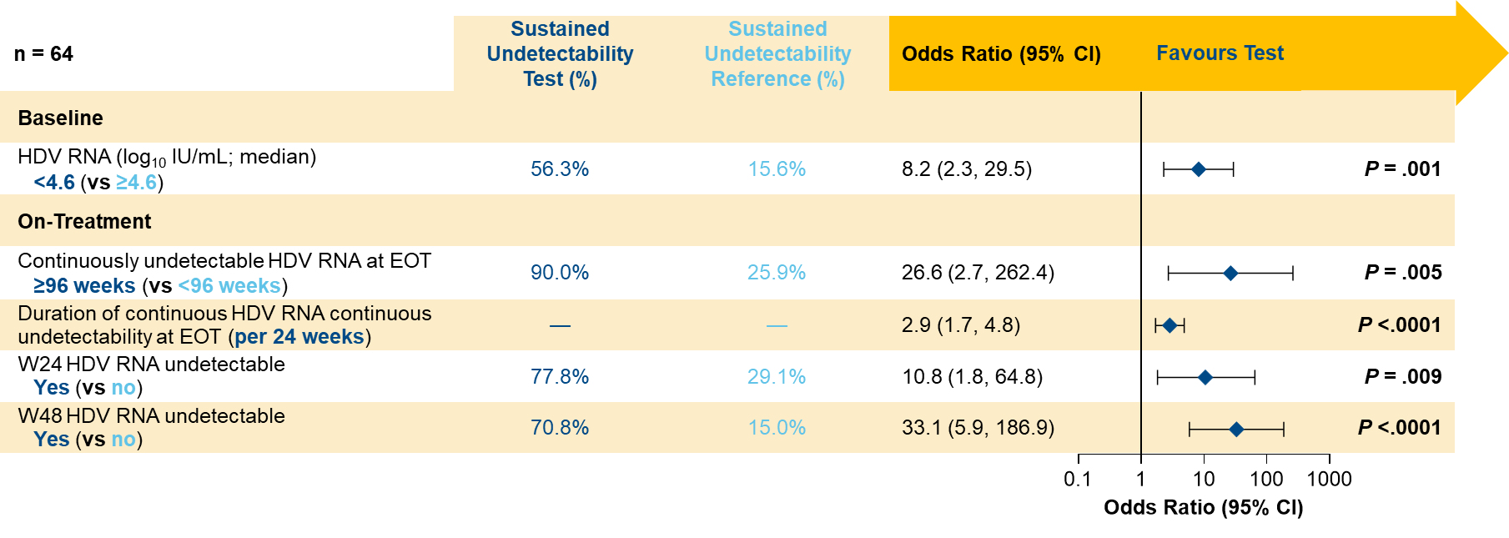
OS-066 Predictors of undetectable hepatitis delta virus RNA at 48 weeks after end of treatment with bulevirtide monotherapy in the MYR 301 study
Results
Sustained undetectability
Predictors of sustained undetectability at FU48
150 patients
65/150 (43%) undetectable at EOT
23/64 (36%)
sustained at FU48
Undetectability rates at EOT were higher in patients on BLV 10 mg.
Sustained undetectable HDV RNA through FU48 was more common in patients who received 3 years of treatment vs 2 years.
The duration of on-treatment undetectable HDV RNA at EOT was the strongest predictor of achieving sustained posttreatment undetectable HDV RNA through 48 weeks after treatment
BLV 2mg (n = 14) | BLV 10mg (n = 25) | Delayed Treatment (n = 26)
50% | 40% | 23%
By treatment arm
Conclusion
In patients with CHD treated with BLV monotherapy for 96W or 144W, achieving undetectable HDV RNA early during treatment and a longer duration of on-treatment HDV RNA undetectability were key predictors of sustained undetectability through 48 weeks of follow-up after treatment discontinuation.
Notes:
Abbreviations: IHC = Inactive HBsAG carriers; PegIFNα = peginterferon alpha; NA = Nucleos(t)ide analogues
OS-066
Predictors of undetectable hepatitis delta virus RNA at 48 weeks after end of treatment with bulevirtide monotherapy in the MYR 301 study
Soo Aleman1, Maurizia Brunetto2 3, Antje Blank4, Pietro Andreone5, Pavel Bogomolov6, Vladimir Chulanov7, Nina Mamonova8, Natalia Geyvandova9, Viacheslav Morozov10, Olga Sagalova11, Tatiana Stepanova12, Amos Lichtman13, Renee-Claude Mercier13, Dmitry Manuilov13, Sarah Arterburn13, Julian Schulze zur Wiesch14, Markus Cornberg15, Stefan Zeuzem16, Pietro Lampertico17 18, Heiner Wedemeyer15
1Department of Infectious Diseases, Karolinska University Hospital/Karolinska Institutet, Stockholm, Sweden, 2Hepatology Unit, Reference Center of the Tuscany Region for Chronic Liver Disease and Cancer, University Hospital of Pisa, Department of Clinical and Experimental Medicine, University of Pisa, Pisa, Italy, 3Department of Clinical and Experimental Medicine, University of Pisa, Pisa, Italy, 4Department of Clinical Pharmacology and Pharmacoepidemiology, Heidelberg University Hospital, Heidelberg, Germany, 5Division of Internal Medicine, University of Modena and Reggio Emilia, Baggiovara Hospital, Modena, Italy, 6M.F. Vladimirsky Moscow Regional Research and Clinical Institute, Moscow, Russian Federation, 7Sechenov University, Moscow, Russian Federation, 8FSBI National Research Medical Center for Phthisiopulmonology and Infectious Diseases of the Ministry of Health of the Russian Federation, Moscow, Russian Federation, 9Stavropol Regional Hospital, Stavropol, Russian Federation, 10LLC Medical Company Hepatolog, Samara, Russian Federation, 11South Ural State Medical University, Chelyabinsk, Russian Federation, 12LLC Clinic of Modern Medicine, Moscow, Russian Federation, 13Gilead Sciences, Inc., Foster City, United States, 14Hepatology Outpatient Medical Clinic, University Hospital Hamburg-Eppendorf, Hamburg, Germany, 15Clinic for Gastroenterology, Hepatology, Infectious Diseases, and Endocrinology, Hannover Medical School, Hannover, Germany, 16Department of Medicine, University Hospital Frankfurt, Frankfurt am Main, Germany, 17Division of Gastroenterology and Hepatology, Foundation IRCCS Ca’ Granda Ospedale Maggiore Policlinico, Milan, Italy, 18CRC “A. M. and A. Migliavacca” Center for Liver Disease, Department of Pathophysiology and Transplantation, University of Milan, Milan, Italy
Email: soo.aleman@ki.se
Background and Aims: Bulevirtide (BLV) is approved in Europe for the treatment of compensated chronic hepatitis delta (CHD). In MYR301, a Phase 3 study evaluating BLV monotherapy for 2–3 years, a subset of patients who achieved undetectable HDV RNA by end of treatment (EOT) maintained undetectable viraemia at 48 weeks (W) after EOT (FU48). Here, we present predictors of sustained HDV RNA undetectability through FU48 after 96W or 144W of BLV treatment.
Method: Data were analysed from 149 patients with CHD in MYR301 who were randomised to immediate treatment with BLV 2 or 10 mg/d for 144W, or to 48W of no treatment followed by BLV 10 mg/d for 96W (DT → 10 mg). All patients were to be followed through FU48. Logistic regression modelling (adjusted for treatment group) was performed to examine potential predictors of sustained HDV RNA undetectability (defined as less than the lower limit of quantitation [LLOQ; target not detected at follow-up in patients with available data]) through FU48 in those with undetectable viraemia at EOT.
Results: Baseline (BL) characteristics were similar between all treatment arms. Across all arms, 65/149 (44%) patients achieved HDV RNA undetectability at EOT, of whom 23/64 (36%) with available follow-up HDV RNA data had sustained undetectability through FU48. Rates of sustained undetectability were higher in the immediate treatment arms (2 mg: 7/14, 50%; 10 mg: 10/25, 40%) vs the delayed treatment arm (DT → 10 mg: 6/26, 23%). Undetectability rates at EOT were higher in patients who received BLV 10 mg, but the relapse rate was lower in the few patients with HDV RNA undetectable in the BLV 2 mg group. BL predictors of sustained undetectability posttreatment included BL HDV RNA less than a median of 4.5 log10 IU/mL (odds ratio [OR]: 6.2; 95% CI [1.9, 20.8]; p = .003) and lower BL hepatitis B surface antigen (HBsAg) level (OR: 0.3 per log10 IU/mL; 95% CI [0.1, 0.8]; p = .019). On-treatment predictors included greater duration of continuous undetectability at EOT (OR per additional week: 1.0; 95% CI [1.0, 1.1]; p < .0001), HBsAg loss or decrease by ≥ 1 log10 IU/mL (OR: 7.2; 95% CI [1.2, 42.3]; p = .030), and W144 antidrug antibody (ADA) incidence (OR: 10.2; 95% CI [1.9, 55.7]; p = .008). The proportion of patients with sustained posttreatment undetectability was 9/10 (90%) in those with ≥ 96W of undetectability at EOT, 11/22 (50%) in those with ≥ 48 to < 96W, and 3/32 (9%) in those with < 48W. Of patients with ADA incidence by W144, 8/10 (80%) had sustained undetectability vs 15/54 (28%) of those without. BL cirrhosis was not a predictor of sustained posttreatment undetectability; 13/32 (41%) with cirrhosis had sustained undetectability vs 10/32 (31%) without cirrhosis.
Conclusion: In patients with CHD treated with BLV monotherapy for 96W or 144W, early and sustained HDV RNA undetectability predicted sustained undetectability during follow-up. Note: PL and HW contributed equally.

Slide 32
OS-067-YI Long term outcomes after nucleos(t)ide analogue cessation – an extended follow up study from the RETRACT-B cohort
Background and Aims
Stopping NAs in a select group of chronic hepatitis B (CHB) patients can result in increased rates of HBsAg loss, however, long-term follow up (FU) data after NA cessation is lacking.
Aim
To assess long-term outcomes after NA withdrawal in patients with CHB.
Methods
Extended FU data collected from patients previously enrolled in the RETRACT-B cohort. New patients included if eligible
Primary outcome
10-year off-treatment HBsAg loss
Secondary outcome
Retreatment- and ALT-flare (≥5xULN) rates
Inclusion criteria
Virally suppressed,
HBeAg negative & HBsAg positive at EOT
Mean age | 52 (±11) years
Gender | 72% Male
Ethnic background | 81% Asian, 15% Caucasian, 4% Black/Other
Treatments | 40% received TDF/TAF 54% ETV
Analysis
Cumulative incidences: derived using Aalen-Johansen (AJ) estimators considering retreatment as competing event.
Gray’s test: used to test equality of these
incidences between different groups.
Exclusion criteria:
History of HCC
Co-infection at EOT
PEG-IFN therapy <1 year prior to EOT
ALT≥5xULN
Notes:
Abbreviations: ALT = Alanine aminotransferase; AJ = Aalen-Johansen; CHB = Chronic hepatitis B; EOT = End of therapy; ETV = Entecavir; FU = Follow-up; HBsAg = Hepatitis B surface antigen; HBeAg = Hepatitis B e antigen; HCC = Hepatocellular carcinoma; IU/mL = International units per millilitre; IQR = Interquartile range; NA = Nucleos(t)ide analogue; off-Rx = Off-treatment; Peg-IFN = Pegylated interferon; TDF/TAF = Tenofovir disoproxil fumarate / Tenofovir alafenamide; ULN = Upper limit of normal.
OS-067-YI
Long term outcomes after nucleos(t)ide analogue cessation – an extended follow up study from the RETRACT-B cohort
Edo J. Dongelmans1, Grishma Hirode2 3 4, Florian van Bömmel5, Rachel Wen-Juei Jeng6, Rong-Nan Chien6, Chien-Hung Chen7, Mai Kilany2 3 4, Tung-Hung Su8, Jia-Horng Kao8, Wai-Kay Seto9, Lilian Liang10, Dag Henrik Reikvam11 12, Marte Holmberg12 13, Arno Furquim d'Almeida14 15, Margarita Papatheodoridi16, Benjamin Maasoumy17, Bettina E. Hansen2 18 19, Anna Pocurull Aparicio20, Norah Terrault21, Marc Ghany22, Asgeir Johannessen11 12 13, Anna Lok23, Thomas Vanwolleghem14 15, Sabela Lens20, Markus Cornberg17 24, Man-Fung Yuen9, Grace Wong10, Milan J. Sonneveld1, George Papatheodoridis16, Thomas Berg5, Yao-Chun (Holden) Hsu25, Jordan J. Feld2 3 4, Harry L.A. Janssen1 2
1Department of Gastroenterology and Hepatology, Erasmus University Medical Center, Rotterdam, Netherlands, 2Toronto Centre for Liver Disease, Toronto General Hospital, University Health Network, Toronto, Canada, 3The Toronto Viral Hepatitis Care Network (VIRCAN), Toronto, Canada, 4Institute of Medical Science, University of Toronto, Toronto, Canada, 5Division of Hepatology, Department of Medicine II, Leipzig University Medical Center, Leipzig, Germany, 6Department of Gastroenterology and Hepatology, Chang Gung Memorial Hospital Linkou Medical Center, Chang Gung University, Taoyuan City, Taiwan, 7Department of Gastroenterology and Hepatology, Kaohsiung Chang Gung Memorial Hospital, Kaohsiung City, Taiwan, 8Department of Internal Medicine, National Taiwan University Hospital, Taipei City, Taiwan, 9Department of Medicine and State Key Laboratory of Liver Research, The University of Hong Kong, Hong Kong, Hong Kong, 10Medical Data Analytics Centre (MDAC), The Chinese University of Hong Kong, Hong Kong, Hong Kong, 11Department of Infectious Diseases, Oslo University Hospital, Oslo, Norway, 12Institute of Clinical Medicine, University of Oslo, Oslo, Norway, 13Department of Infectious Diseases, Vestfold Hospital, Tønsberg, Norway, 14Department of Gastroenterology and Hepatology, Antwerp University Hospital, Antwerp, Belgium, 15Viral Hepatitis Research Group, Laboratory of Experimental Medicine and Pediatrics, University of Antwerp, Antwerp, Belgium, 161st Department of Gastroenterology, Medical School of National and Kapodistrian University of Athens, General Hospital of Athens “Laiko”, Athens, Greece, 17Department of Gastroenterology, Hepatology, Infectious Diseases and Endocrinology, Hannover Medical School, Hannover, Germany, 18Department of Epidemiology, Biostatistics, Erasmus University Medical Center, Rotterdam, Netherlands, 19Institute of Health Policy, Management and Evaluation, University of Toronto, Toronto, Netherlands, 20Liver Unit, Hospital Clinic Barcelona, IDIBAPS and CIBEREHD, University of Barcelona, Barcelona, Spain, 21Gastrointestinal and Liver Diseases Division, Keck Medicine of University of Southern California, Los Angeles, United States, 22Liver Diseases Branch, National Institutes of Diabetes and Digestive and Kidney Diseases, National Institutes of Health, Bethesda, United States, 23Division of Gastroenterology and Hepatology, University of Michigan, Ann Arbor, United States, 24Centre for Individualised Infection Medicine (CiiM), A Joint Venture of Helmholtz Centre for Infection Research and Hannover Medical School, Hannover, Germany, 25Department of Medical Research, School of Medicine, E-Da Hospital/I-Shou University, Kaohsiung City, Taiwan
Email: e.dongelmans@erasmusmc.nl
Background and Aims: Stopping nucleos(t)ide analogues (NA) in a selected group of patients with chronic hepatitis B (CHB) can result in increased rates of HBsAg loss. However, long-term follow up (FU) data after NA cessation is lacking. This study aimed to assess the long-term outcomes after NA withdrawal in a large global cohort.
Method: Extended FU data were collected from patients previously enrolled in the RETRACT-B cohort. New patients were added if they met the inclusion criteria, i.e. virally suppressed, HBeAg negative and HBsAg positive at end of therapy (EOT). Patients with a history of HCC, co-infection at EOT, Peg-IFN therapy <1 year prior to EOT or ALT≥5xULN at EOT, were excluded. Retreatment criteria were study specific or according to local guidelines.
The primary outcome was the 10-year off-treatment (off-Rx) HBsAg loss rate. Secondary outcomes were retreatment- and ALT-flare (≥5xULN) rates. Time to event was defined until HBsAg loss or loss to follow up, censoring if therapy was re-stopped. Cumulative incidences were derived using Aalen-Johansen (AJ) estimators considering retreatment as competing event. Gray’s test was used to test equality of these incidences between different groups.
Results: In total, 2029 patients were included. At EOT, mean age was 52 (±11) years, 1647 (81%) were Asian, 299 (15%) Caucasian, and 83 (4%) Black/other. 1464 (72%) were male and 801 (40%) received TDF/TAF and 1094 (54%) ETV. 211 (10%) patients had a history of cirrhosis, 283 (14%) were HBeAg positive at start of therapy and median treatment duration was 3 [IQR 3-5] years. Mean HBsAg at EOT was 2.7 (±0.8) log10 IU/mL (<100 / 100-1000 / >1000: 16 / 45 / 38%) and median ALT was 23 [18-32] U/L.
Median total and off-Rx FU time after EOT were 65 [36-99] and 28 [10-66] months, respectively. The 10-year cumulative incidence for off-Rx HBsAg loss was 17% (<100 / 100-1000 / >1000: 53 / 13 / 6%, p<0.001) and 4% for HBsAg loss after retreatment. When applying the RETRACT-B stopping criteria, 8-year off-Rx HBsAg loss was 56% for Caucasian <1000 IU/mL vs. 43% for Asian <100 IU/mL, compared to 5% and 5% when not meeting these criteria (p<0.001). Results were consistent in newly included patients.
The 10-year retreatment rate was 59% (<100 / 100-1000 / >1000 IU/mL: 27 / 62 / 71%). The 5- and 10-year cumulative incidence for ALT-flares were 29 and 30%, respectively. 55 (3%) patients developed hepatic decompensation, of whom 19 (35%) had clinical symptoms (i.e. jaundice, ascites, hepatic encephalopathy or variceal bleeding). 41 (2%) patients died of whom 16 due to liver related events (e.g. HCC).
Conclusion: The 10-year cumulative off-treatment HBsAg loss rate was 17%, with more than half of the patients being retreated. Patients with HBsAg levels <100 IU/mL seem to benefit the most from NA cessation (HBsAg loss rate 53%), whereas NA withdrawal in patients >1000 IU/mL should be discouraged when aiming for functional cure (HBsAg loss rate 6%).

Slide 33
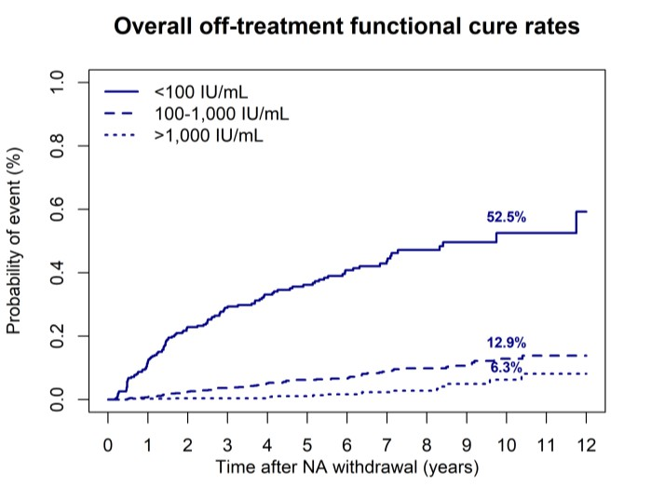
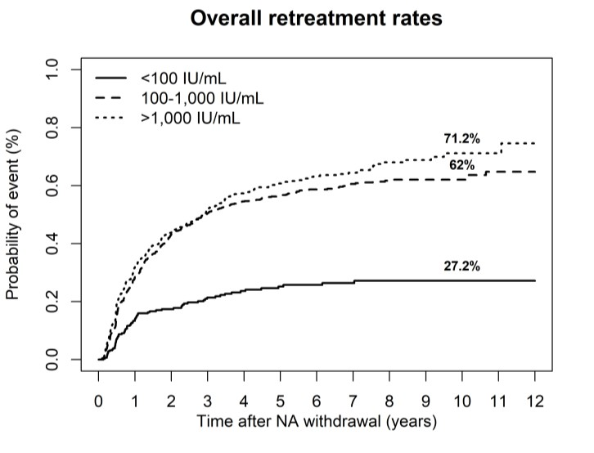
OS-067-YI Long term outcomes after nucleos(t)ide analogue cessation – an extended follow up study from the RETRACT-B cohort
Results
Conclusion
Patient Characteristics at EOT
Median treatment duration | 3 years [IQR 3–5]
Mean HBsAg | 2.7 (±0.8) log₁₀ IU/mL
HBsAg categories | <100: 16%, 100–1000: 45%, >1000: 38%
The 10-year cumulative off-treatment HBsAg loss rate was 17%.
More than half of the patients were retreated.
Patients with HBsAg levels <100 IU/mL seem to benefit the most from NA cessation (HBsAg loss rate 53%).
NA withdrawal in patients >1000 IU/mL should be discouraged when aiming for functional cure (HBsAg loss rate 6%).
Follow-up Duration & Outcomes
Measure | Value
Median total FU | 65 months [IQR 36–99]
Median off- treatment FU | 28 months [IQR 10–66]
10-year HBsAg loss | 17% overall
HBsAg loss by EOT HBsAg | <100: 53%, 100–1000: 13%, >1000: 6%
HBsAg loss after retreatment | +4%
10-year retreatment rate | 59% overall (range: 27–71% by HBsAg)
ALT flares ≥5xULN | 29% (5y), 30% (10y)
Hepatic decompensation | 3% (35% symptomatic)
Deaths | 2% (n=41), 16 liver-related
Notes:
Abbreviations: ALT = Alanine aminotransferase; AJ = Aalen-Johansen; CHB = Chronic hepatitis B; EOT = End of therapy; ETV = Entecavir; FU = Follow-up; HBsAg = Hepatitis B surface antigen; HBeAg = Hepatitis B e antigen; HCC = Hepatocellular carcinoma; IQR = Interquartile range; NA = Nucleos(t)ide analogue; off-Rx = Off-treatment; Peg-IFN = Pegylated interferon; TDF/TAF = Tenofovir disoproxil fumarate / Tenofovir alafenamide; ULN = Upper limit of normal.
OS-067-YI
Long term outcomes after nucleos(t)ide analogue cessation – an extended follow up study from the RETRACT-B cohort
Edo J. Dongelmans1, Grishma Hirode2 3 4, Florian van Bömmel5, Rachel Wen-Juei Jeng6, Rong-Nan Chien6, Chien-Hung Chen7, Mai Kilany2 3 4, Tung-Hung Su8, Jia-Horng Kao8, Wai-Kay Seto9, Lilian Liang10, Dag Henrik Reikvam11 12, Marte Holmberg12 13, Arno Furquim d'Almeida14 15, Margarita Papatheodoridi16, Benjamin Maasoumy17, Bettina E. Hansen2 18 19, Anna Pocurull Aparicio20, Norah Terrault21, Marc Ghany22, Asgeir Johannessen11 12 13, Anna Lok23, Thomas Vanwolleghem14 15, Sabela Lens20, Markus Cornberg17 24, Man-Fung Yuen9, Grace Wong10, Milan J. Sonneveld1, George Papatheodoridis16, Thomas Berg5, Yao-Chun (Holden) Hsu25, Jordan J. Feld2 3 4, Harry L.A. Janssen1 2
1Department of Gastroenterology and Hepatology, Erasmus University Medical Center, Rotterdam, Netherlands, 2Toronto Centre for Liver Disease, Toronto General Hospital, University Health Network, Toronto, Canada, 3The Toronto Viral Hepatitis Care Network (VIRCAN), Toronto, Canada, 4Institute of Medical Science, University of Toronto, Toronto, Canada, 5Division of Hepatology, Department of Medicine II, Leipzig University Medical Center, Leipzig, Germany, 6Department of Gastroenterology and Hepatology, Chang Gung Memorial Hospital Linkou Medical Center, Chang Gung University, Taoyuan City, Taiwan, 7Department of Gastroenterology and Hepatology, Kaohsiung Chang Gung Memorial Hospital, Kaohsiung City, Taiwan, 8Department of Internal Medicine, National Taiwan University Hospital, Taipei City, Taiwan, 9Department of Medicine and State Key Laboratory of Liver Research, The University of Hong Kong, Hong Kong, Hong Kong, 10Medical Data Analytics Centre (MDAC), The Chinese University of Hong Kong, Hong Kong, Hong Kong, 11Department of Infectious Diseases, Oslo University Hospital, Oslo, Norway, 12Institute of Clinical Medicine, University of Oslo, Oslo, Norway, 13Department of Infectious Diseases, Vestfold Hospital, Tønsberg, Norway, 14Department of Gastroenterology and Hepatology, Antwerp University Hospital, Antwerp, Belgium, 15Viral Hepatitis Research Group, Laboratory of Experimental Medicine and Pediatrics, University of Antwerp, Antwerp, Belgium, 161st Department of Gastroenterology, Medical School of National and Kapodistrian University of Athens, General Hospital of Athens “Laiko”, Athens, Greece, 17Department of Gastroenterology, Hepatology, Infectious Diseases and Endocrinology, Hannover Medical School, Hannover, Germany, 18Department of Epidemiology, Biostatistics, Erasmus University Medical Center, Rotterdam, Netherlands, 19Institute of Health Policy, Management and Evaluation, University of Toronto, Toronto, Netherlands, 20Liver Unit, Hospital Clinic Barcelona, IDIBAPS and CIBEREHD, University of Barcelona, Barcelona, Spain, 21Gastrointestinal and Liver Diseases Division, Keck Medicine of University of Southern California, Los Angeles, United States, 22Liver Diseases Branch, National Institutes of Diabetes and Digestive and Kidney Diseases, National Institutes of Health, Bethesda, United States, 23Division of Gastroenterology and Hepatology, University of Michigan, Ann Arbor, United States, 24Centre for Individualised Infection Medicine (CiiM), A Joint Venture of Helmholtz Centre for Infection Research and Hannover Medical School, Hannover, Germany, 25Department of Medical Research, School of Medicine, E-Da Hospital/I-Shou University, Kaohsiung City, Taiwan
Email: e.dongelmans@erasmusmc.nl
Background and Aims: Stopping nucleos(t)ide analogues (NA) in a selected group of patients with chronic hepatitis B (CHB) can result in increased rates of HBsAg loss. However, long-term follow up (FU) data after NA cessation is lacking. This study aimed to assess the long-term outcomes after NA withdrawal in a large global cohort.
Method: Extended FU data were collected from patients previously enrolled in the RETRACT-B cohort. New patients were added if they met the inclusion criteria, i.e. virally suppressed, HBeAg negative and HBsAg positive at end of therapy (EOT). Patients with a history of HCC, co-infection at EOT, Peg-IFN therapy <1 year prior to EOT or ALT≥5xULN at EOT, were excluded. Retreatment criteria were study specific or according to local guidelines.
The primary outcome was the 10-year off-treatment (off-Rx) HBsAg loss rate. Secondary outcomes were retreatment- and ALT-flare (≥5xULN) rates. Time to event was defined until HBsAg loss or loss to follow up, censoring if therapy was re-stopped. Cumulative incidences were derived using Aalen-Johansen (AJ) estimators considering retreatment as competing event. Gray’s test was used to test equality of these incidences between different groups.
Results: In total, 2029 patients were included. At EOT, mean age was 52 (±11) years, 1647 (81%) were Asian, 299 (15%) Caucasian, and 83 (4%) Black/other. 1464 (72%) were male and 801 (40%) received TDF/TAF and 1094 (54%) ETV. 211 (10%) patients had a history of cirrhosis, 283 (14%) were HBeAg positive at start of therapy and median treatment duration was 3 [IQR 3-5] years. Mean HBsAg at EOT was 2.7 (±0.8) log10 IU/mL (<100 / 100-1000 / >1000: 16 / 45 / 38%) and median ALT was 23 [18-32] U/L.
Median total and off-Rx FU time after EOT were 65 [36-99] and 28 [10-66] months, respectively. The 10-year cumulative incidence for off-Rx HBsAg loss was 17% (<100 / 100-1000 / >1000: 53 / 13 / 6%, p<0.001) and 4% for HBsAg loss after retreatment. When applying the RETRACT-B stopping criteria, 8-year off-Rx HBsAg loss was 56% for Caucasian <1000 IU/mL vs. 43% for Asian <100 IU/mL, compared to 5% and 5% when not meeting these criteria (p<0.001). Results were consistent in newly included patients.
The 10-year retreatment rate was 59% (<100 / 100-1000 / >1000 IU/mL: 27 / 62 / 71%). The 5- and 10-year cumulative incidence for ALT-flares were 29 and 30%, respectively. 55 (3%) patients developed hepatic decompensation, of whom 19 (35%) had clinical symptoms (i.e. jaundice, ascites, hepatic encephalopathy or variceal bleeding). 41 (2%) patients died of whom 16 due to liver related events (e.g. HCC).
Conclusion: The 10-year cumulative off-treatment HBsAg loss rate was 17%, with more than half of the patients being retreated. Patients with HBsAg levels <100 IU/mL seem to benefit the most from NA cessation (HBsAg loss rate 53%), whereas NA withdrawal in patients >1000 IU/mL should be discouraged when aiming for functional cure (HBsAg loss rate 6%).

Slide 34
Late Breaker

Slide 35
LB25221 Final results of MYR301: a randomised phase 3 study evaluating the efficacy and safety of up to 144
weeks of bulevirtide monotherapy for chronic hepatitis delta and 96 weeks of posttreatment follow-up
Background and Aims
Methods
BLV 2 mg is s approved in the European Economic Area, Great Britain, Switzerland, the Russian Federation, and Australia for the treatment of compensated chronic hepatitis delta (CHD).
MYR301 was a Phase 3 study evaluating BLV monotherapy for 2 to 3 years during which BLV treatment was safe and effective through 144 weeks (W).
N = 150 randomised to:
BLV
2 mg/day 144 weeks
BLV
10 mg/day
144 weeks
Delayed treatment 48 weeks no treatment then BLV 10 mg/day for 96 weeks
96 weeks of posttreatment follow-up
Efficacy endpoints
Aim: To evaluate the long-term safety and efficacy through 96 weeks of posttreatment follow-up (FU96) following 96 or 144W BLV monotherapy for compensated CHD.
Virologic Response (VR)
Undetectable HDV RNA or ≥2 log₁₀ IU/mL decline from baseline.
Combined Response
VR and
ALT normalisation
ALT normalisation
≤31 U/L for females and ≤41 U/L for males (Russian sites).
≤34 U/L for females and ≤49 U/L for males (all other sites).
Undetectable HDV RNA
Primary analysis: Intention to treat. Missing data = failures.
Notes:
Abbreviations: ALT = Alanine aminotransferase; BLV = Bulevirtide; CHD = Chronic Hepatitis Delta; FU = Follow-up; EOT = End of treatment
LB25221
Final results of MYR301: a randomised phase 3 study evaluating the efficacy and safety of up to 144 weeks of bulevirtide monotherapy for chronic hepatitis delta and 96 weeks of posttreatment follow-up
Heiner Wedemeyer1, Soo Aleman2, Antje Blank3, Pietro Andreone4, Pavel Bogomolov5, Vladimir Chulanov6, Nina Mamonova7, Natalia Geyvandova8, Viacheslav Morozov9, Olga Sagalova10, Tatiana Stepanova11, Annemarie Berger12, Sandra Ciesek12, Amos Lichtman13, Dmitry Manuilov13, Renee-Claude Mercier13, Sarah Arterburn13, Florence Christian-Cox13, Steve Tseng13, Anu Osinusi13, Julian Schulze zur Wiesch14, Markus Cornberg1, Stefan Zeuzem15, Maurizia Brunetto16 17, Pietro Lampertico18 19
1Clinic for Gastroenterology, Hepatology, Infectious Diseases, and Endocrinology, Hannover Medical School, Hannover, Germany, 2Department of Infectious Diseases, Karolinska University Hospital/Karolinska Institutet, Stockholm, Sweden, 3Medical Faculty Heidelberg/Heidelberg University Hospital, Department of Clinical Pharmacology and Pharmacoepidemiology, Heidelberg, Germany, 4Department of Internal Medicine, Baggiovara Hospital, University of Modena and Reggio Emilia, Modena, Italy, 5M.F. Vladimirsky Moscow Regional Research and Clinical Institute, Moscow, Russian Federation, 6Sechenov University, Moscow, Russian Federation, 7FSBI National Research Medical Center for Phthisiopulmonology and Infectious Diseases of the Ministry of Health of the Russian Federation, Moscow, Russian Federation, 8Stavropol Regional Hospital, Stavropol, Russian Federation, 9LLC Medical Company “Hepatolog”, Samara, Russian Federation, 10South Ural State Medical University, Chelyabinsk, Russian Federation, 11LLC Clinic of Modern Medicine, Moscow, Russian Federation, 12External partner site Frankfurt, German Center for Infection Research (DZIF), Institute for Medical Virology, University Hospital Frankfurt, Goethe University Frankfurt, Frankfurt, Germany, 13Gilead Sciences, Inc., Foster City, United States, 14Hepatology Outpatient Medical Clinic, University Hospital Hamburg-Eppendorf, Hamburg, Germany, 15Department of Medicine, University Hospital, Goethe University Frankfurt, Frankfurt, Germany, 16Hepatology Unit, Reference Center of the Tuscany Region for Chronic Liver Disease and Cancer, University Hospital of Pisa, Pisa, Italy, 17Department of Clinical and Experimental Medicine, University of Pisa, Pisa, Italy, 18Division of Gastroenterology and Hepatology, Foundation IRCCS Ca’ Granda Ospedale Maggiore Policlinico, Milan, Italy, 19CRC “A. M. and A. Migliavacca” Center for Liver Disease, Department of Pathophysiology and Transplantation, University of Milan, Milan, Italy
Email: wedemeyer.heiner@mh-hannover.de
Background and Aims: Bulevirtide (BLV) 2 mg/day (d) is approved in Europe, Australia, and Russia for treatment of compensated chronic hepatitis delta (CHD). In MYR301, a Phase 3 study evaluating BLV monotherapy for 2 to 3 years, BLV treatment was safe and effective through 144 weeks (W). We present final MYR301 results through follow-up at 96W after end of treatment (EOT; FU96).
Method: Patients with CHD and compensated liver disease (N = 150) were randomised to immediate treatment with BLV 2 or 10 mg/d for 144W or to 48W of delayed treatment (DT) followed by BLV 10 mg/d for 96W (DT to 10 mg) and 96W posttreatment FU. Efficacy endpoints included virologic response (VR; undetectable hepatitis delta virus [HDV] RNA or ≥ 2 log10 IU/mL decline from baseline [BL]), combined response (CR; VR and alanine aminotransferase [ALT] normalisation), ALT normalisation, undetectable HDV RNA, and hepatitis B surface antigen (HBsAg) loss. The primary analysis was intention to treat, with missing data considered failures.
Results: BL characteristics were previously reported and similar across groups. Most patients (92%) remained in the study at EOT; 72% and 57% completed FU48 and FU96, respectively. CR rates in the 2, 10, and DT to 10 mg groups, respectively, declined from 57%, 54%, and 56% at EOT to 24% in each group at FU96. HDV RNA undetectability rates in these groups were 29%, 50%, and 52% at EOT and 20%, 22%, and 20% at FU96. Of the 64 patients across all groups with undetectable HDV RNA at EOT and available FU data, 23 (36%) had sustained undetectable HDV RNA through FU96, and 41 patients had viral relapse, which occurred in 38 (93%) by FU24 and none after FU48. Sustained posttreatment undetectable HDV RNA was more frequent in patients with longer on-treatment continuous HDV RNA undetectability at EOT: 9/10 (90%) for ≥ 96 weeks, 11/22 (50%) for ≥ 48 to < 96 weeks, and 3/32 (9%) for 0 to < 48 weeks. Posttreatment HBsAg loss occurred in 3 patients. In the posttreatment period, 14/142 (10%) patients had ALT > 10 × the upper limit of normal (ULN), which occurred by FU24 in most (10/14, 71%). Posttreatment hepatic serious adverse events (SAEs) were reported in 20/142 (14%) patients: 7 had ALT > 10 × ULN, 15 had HDV rebound (HDV RNA increased ≥ 2 log10 IU/mL from EOT), and 4 had liver-related hospitalisation (including 1 case of oesophageal varices haemorrhage); 1 additional patient experienced nonserious ascites. The hepatic SAEs resolved in 17/20 (85%) patients, ≥ 16 of whom restarted BLV.
Conclusion: In patients with CHD treated with BLV monotherapy for 96W or 144W, response rates decreased after treatment discontinuation. However, a subset of patients maintained undetectable HDV RNA for 2 years posttreatment, which was associated with longer duration of continuous on-treatment undetectability. Posttreatment viral relapse occurred only in the first year after EOT and may be associated with hepatitis flares.

Slide 36
LB25221 Final results of MYR301: a randomised phase 3 study evaluating the efficacy and safety of up to 144
weeks of bulevirtide monotherapy for chronic hepatitis delta and 96 weeks of posttreatment follow-up
Results
Conclusion
HDV Undetectability
Combined response (CR)
In patients with CHD treated with BLV monotherapy for 96 or 144 weeks, response rates declined after EOT; viral rebound in the posttreatment period may be associated with ALT flares.
Among patients who achieved undetectable HDV RNA at the EOT, a subset sustained undetectable HDV RNA for 2 years posttreatment.
No relapses occurred in the second year of follow-up and patients with on-treatment undetectability of at least 2 years prior to stopping BLV were highly unlikely to relapse.
 | EOT | FU96
BLV 2 mg | 29% | 20%
BLV 10 mg | 50% | 22%
DT to BLV 10 mg | 52% | 20%
 | EOT | FU96
BLV 2 mg | 57% | 24%
BLV 10 mg | 54% | 24%
DT to BLV 10 mg | 56% | 24%
36% (23/64) maintained sustained undetectability with no relapses during follow-up.
Longer duration of on-treatment undetectability at EOT = better durability.
CR rates dropped from EOT to FU96
ALT and hepatic safety
≥96W: 90%
48–96W: 50%
<48W: 9%
10% (14/142) had ALT >10 × ULN (most occurred by FU24)
14% (20/142) had hepatic SAEs
7 with ALT >10 × ULN
15 with HDV rebound
4 had liver-related hospitalisations
Hepatic SAEs resolved in 85% (17/20) of patients, of whom ≥16 restarted BLV
Duration of undetectable HDV RNA at EOT: Proportion with sustained undetectability throughout follow-up
92% of patients remained in study at EOT, 72% completed FU48, and 57% completed FU96.
Of the 64 patients across all groups with undetectable HDV RNA at EOT, 41 (64%) had posttreatment viral relapse.
Relapse occurred in 38 (93%) by FU24, and none after FU48
Notes:
Abbreviations: ALT = Alanine aminotransferase; BLV = Bulevirtide; CHD = Chronic Hepatitis Delta; FU = Follow-up; EOT = End of treatment
of treatment
LB25221
Final results of MYR301: a randomised phase 3 study evaluating the efficacy and safety of up to 144 weeks of bulevirtide monotherapy for chronic hepatitis delta and 96 weeks of posttreatment follow-up
Heiner Wedemeyer1, Soo Aleman2, Antje Blank3, Pietro Andreone4, Pavel Bogomolov5, Vladimir Chulanov6, Nina Mamonova7, Natalia Geyvandova8, Viacheslav Morozov9, Olga Sagalova10, Tatiana Stepanova11, Annemarie Berger12, Sandra Ciesek12, Amos Lichtman13, Dmitry Manuilov13, Renee-Claude Mercier13, Sarah Arterburn13, Florence Christian-Cox13, Steve Tseng13, Anu Osinusi13, Julian Schulze zur Wiesch14, Markus Cornberg1, Stefan Zeuzem15, Maurizia Brunetto16 17, Pietro Lampertico18 19
1Clinic for Gastroenterology, Hepatology, Infectious Diseases, and Endocrinology, Hannover Medical School, Hannover, Germany, 2Department of Infectious Diseases, Karolinska University Hospital/Karolinska Institutet, Stockholm, Sweden, 3Medical Faculty Heidelberg/Heidelberg University Hospital, Department of Clinical Pharmacology and Pharmacoepidemiology, Heidelberg, Germany, 4Department of Internal Medicine, Baggiovara Hospital, University of Modena and Reggio Emilia, Modena, Italy, 5M.F. Vladimirsky Moscow Regional Research and Clinical Institute, Moscow, Russian Federation, 6Sechenov University, Moscow, Russian Federation, 7FSBI National Research Medical Center for Phthisiopulmonology and Infectious Diseases of the Ministry of Health of the Russian Federation, Moscow, Russian Federation, 8Stavropol Regional Hospital, Stavropol, Russian Federation, 9LLC Medical Company “Hepatolog”, Samara, Russian Federation, 10South Ural State Medical University, Chelyabinsk, Russian Federation, 11LLC Clinic of Modern Medicine, Moscow, Russian Federation, 12External partner site Frankfurt, German Center for Infection Research (DZIF), Institute for Medical Virology, University Hospital Frankfurt, Goethe University Frankfurt, Frankfurt, Germany, 13Gilead Sciences, Inc., Foster City, United States, 14Hepatology Outpatient Medical Clinic, University Hospital Hamburg-Eppendorf, Hamburg, Germany, 15Department of Medicine, University Hospital, Goethe University Frankfurt, Frankfurt, Germany, 16Hepatology Unit, Reference Center of the Tuscany Region for Chronic Liver Disease and Cancer, University Hospital of Pisa, Pisa, Italy, 17Department of Clinical and Experimental Medicine, University of Pisa, Pisa, Italy, 18Division of Gastroenterology and Hepatology, Foundation IRCCS Ca’ Granda Ospedale Maggiore Policlinico, Milan, Italy, 19CRC “A. M. and A. Migliavacca” Center for Liver Disease, Department of Pathophysiology and Transplantation, University of Milan, Milan, Italy
Email: wedemeyer.heiner@mh-hannover.de
Background and Aims: Bulevirtide (BLV) 2 mg/day (d) is approved in Europe, Australia, and Russia for treatment of compensated chronic hepatitis delta (CHD). In MYR301, a Phase 3 study evaluating BLV monotherapy for 2 to 3 years, BLV treatment was safe and effective through 144 weeks (W). We present final MYR301 results through follow-up at 96W after end of treatment (EOT; FU96).
Method: Patients with CHD and compensated liver disease (N = 150) were randomised to immediate treatment with BLV 2 or 10 mg/d for 144W or to 48W of delayed treatment (DT) followed by BLV 10 mg/d for 96W (DT to 10 mg) and 96W posttreatment FU. Efficacy endpoints included virologic response (VR; undetectable hepatitis delta virus [HDV] RNA or ≥ 2 log10 IU/mL decline from baseline [BL]), combined response (CR; VR and alanine aminotransferase [ALT] normalisation), ALT normalisation, undetectable HDV RNA, and hepatitis B surface antigen (HBsAg) loss. The primary analysis was intention to treat, with missing data considered failures.
Results: BL characteristics were previously reported and similar across groups. Most patients (92%) remained in the study at EOT; 72% and 57% completed FU48 and FU96, respectively. CR rates in the 2, 10, and DT to 10 mg groups, respectively, declined from 57%, 54%, and 56% at EOT to 24% in each group at FU96. HDV RNA undetectability rates in these groups were 29%, 50%, and 52% at EOT and 20%, 22%, and 20% at FU96. Of the 64 patients across all groups with undetectable HDV RNA at EOT and available FU data, 23 (36%) had sustained undetectable HDV RNA through FU96, and 41 patients had viral relapse, which occurred in 38 (93%) by FU24 and none after FU48. Sustained posttreatment undetectable HDV RNA was more frequent in patients with longer on-treatment continuous HDV RNA undetectability at EOT: 9/10 (90%) for ≥ 96 weeks, 11/22 (50%) for ≥ 48 to < 96 weeks, and 3/32 (9%) for 0 to < 48 weeks. Posttreatment HBsAg loss occurred in 3 patients. In the posttreatment period, 14/142 (10%) patients had ALT > 10 × the upper limit of normal (ULN), which occurred by FU24 in most (10/14, 71%). Posttreatment hepatic serious adverse events (SAEs) were reported in 20/142 (14%) patients: 7 had ALT > 10 × ULN, 15 had HDV rebound (HDV RNA increased ≥ 2 log10 IU/mL from EOT), and 4 had liver-related hospitalisation (including 1 case of oesophageal varices haemorrhage); 1 additional patient experienced nonserious ascites. The hepatic SAEs resolved in 17/20 (85%) patients, ≥ 16 of whom restarted BLV.
Conclusion: In patients with CHD treated with BLV monotherapy for 96W or 144W, response rates decreased after treatment discontinuation. However, a subset of patients maintained undetectable HDV RNA for 2 years posttreatment, which was associated with longer duration of continuous on-treatment undetectability. Posttreatment viral relapse occurred only in the first year after EOT and may be associated with hepatitis flares.

